Slide 1
Active Online Reading: Student Behaviours vs. Staff Expectations
Jamie Wood (University of Lincoln) and Matt East (Talis)

Slide 2
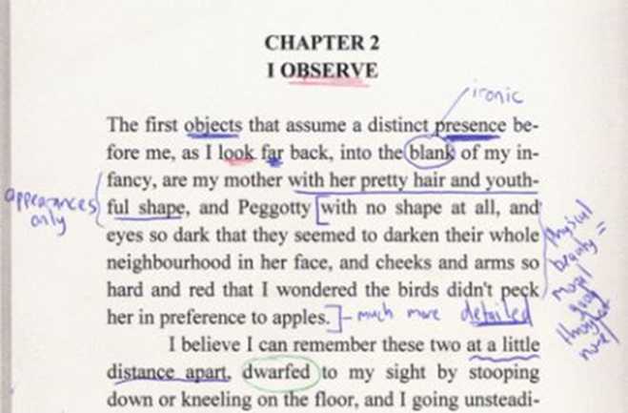
Today
Introducing the project
Overview of some key findings of our survey
Focus on L1 undergraduates
Summing up

Slide 3
The Active online reading project
QAA-funded Collaborative Enhancement Project
April 2021-April 2022
Building on community of practice in History
Working with other disciplines and institutions
Teachers and teacher educators
Student researchers

Slide 4
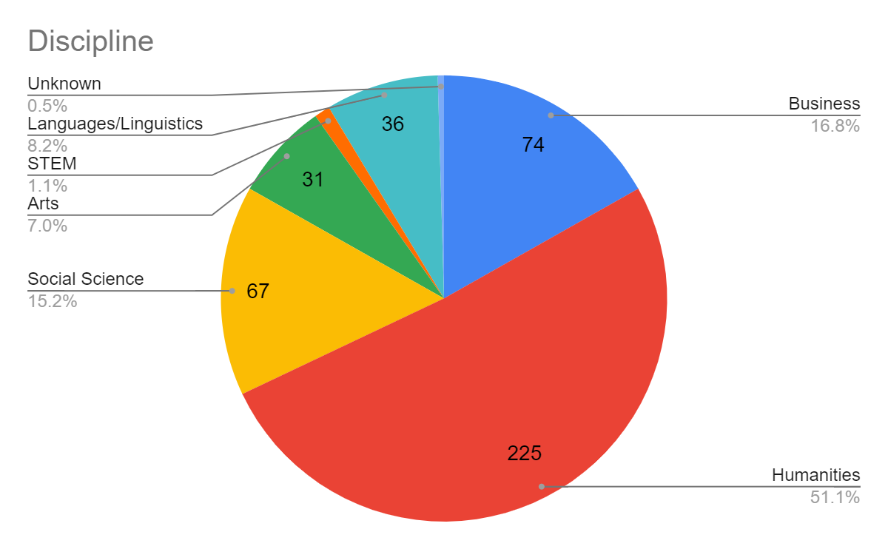
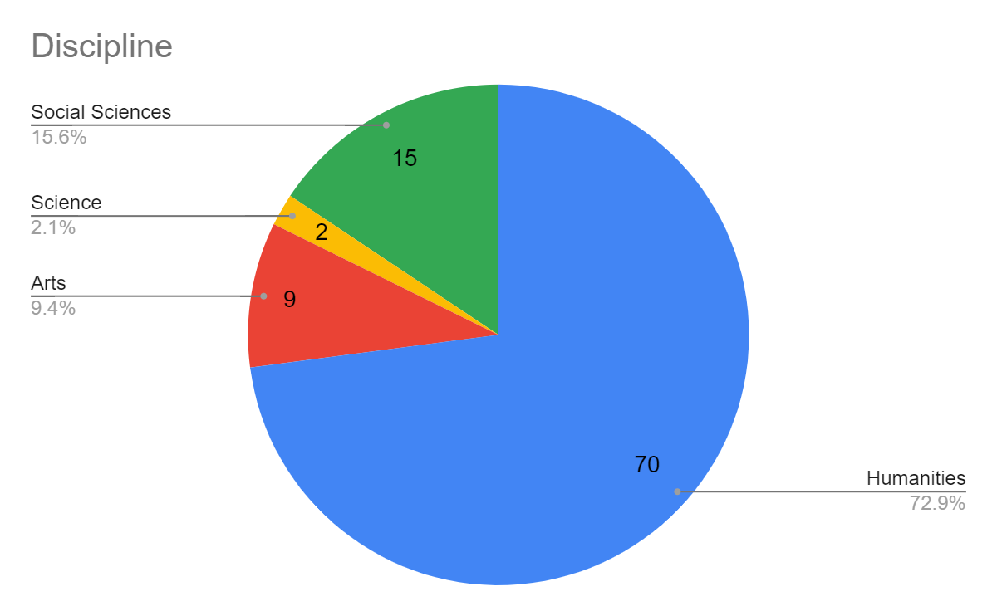
Survey (November 2021-January 2022)
Students
Student survey: 442 responses
15% self-identified as having a disability that affects their ability to read
Staff survey: 98 responses
10 countries
50+ institutions
Humanities-heavy sample
Staff

Slide 5
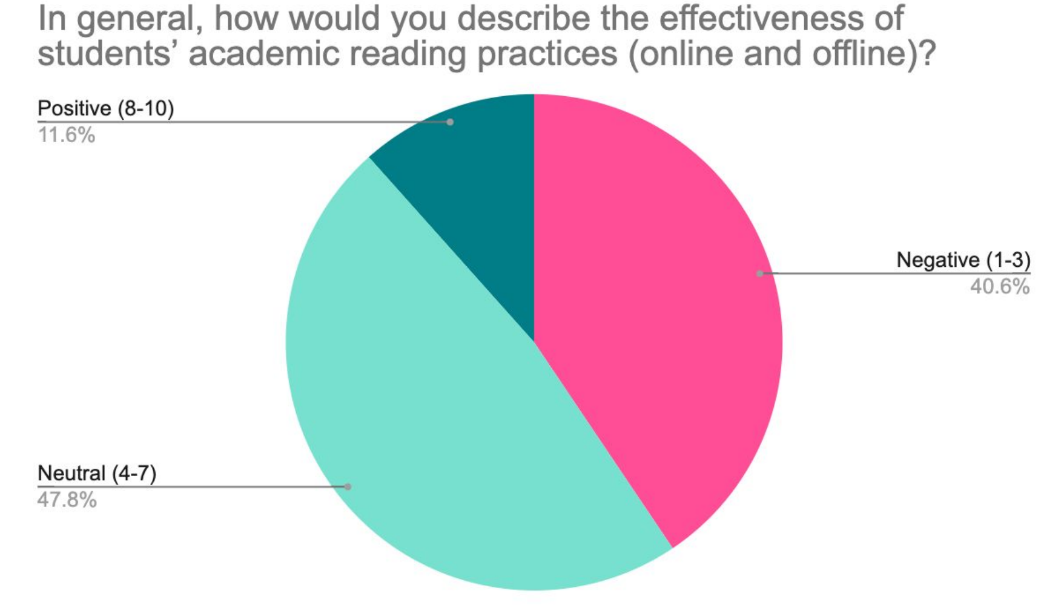
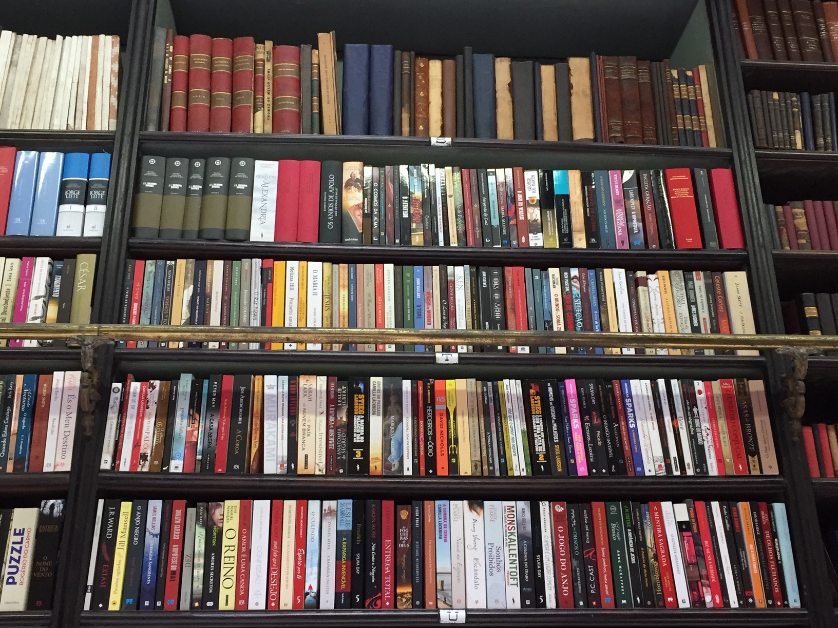
‘Students often struggle with academic reading in particular, unfamiliar vocabulary or theories can be a big barrier for less confident students, who do not have the skill or confidence to get the gist of a work (or read around unfamiliar material) and then go back and tackle questions or issues with the reading.’ (Librarian, UK)

Slide 6
Students’ academic reading practices (online and offline) and challenges
Deficit approach
Students not understanding texts and arguments
Relationship to general study habits/ skills
Intrinsic motivation key
Lack of initiative
Transition critical, though improvement over time
Digital distraction
Social media perceived to have a negative impact
‘Once students know what they are supposed to read, for when, and have been given some grounding of the different reading skills required at University, I've generally found a good rate of engagement for most, with the usual candidates not engaging. The biggest problems I encounter are that there seems to be very little tenacity or resourcefulness […].’ (Arts/Creative Industries, UK)

Slide 7
How important is online reading to students’ learning in your discipline?
Consensus on importance of online reading
Many set all readings in digital formats
Accessibility and cost common factors in this choice
‘Online reading ensures accessibility for all and can be specific in terms of the texts selected.’ (Education, UK)
‘It's fundamental to finding information and engaging with it within the discipline, from navigating virtual learning environments and timetables to conducting research and producing assessments. Nowadays, it underpins most student work and this is only likely to increase in future.’ (History, UK)
‘Campus-Based reading is increasingly done online (esp. since 2020). All readings are available electronically, and I suspect that only a minority of students download readings or print them out. The library collection still gets used though, especially for assignments (which is when much of the reading gets done).’ (History, UK)

Slide 8
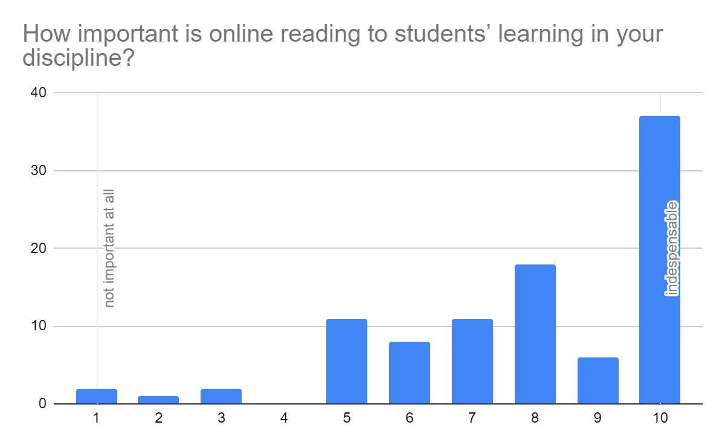
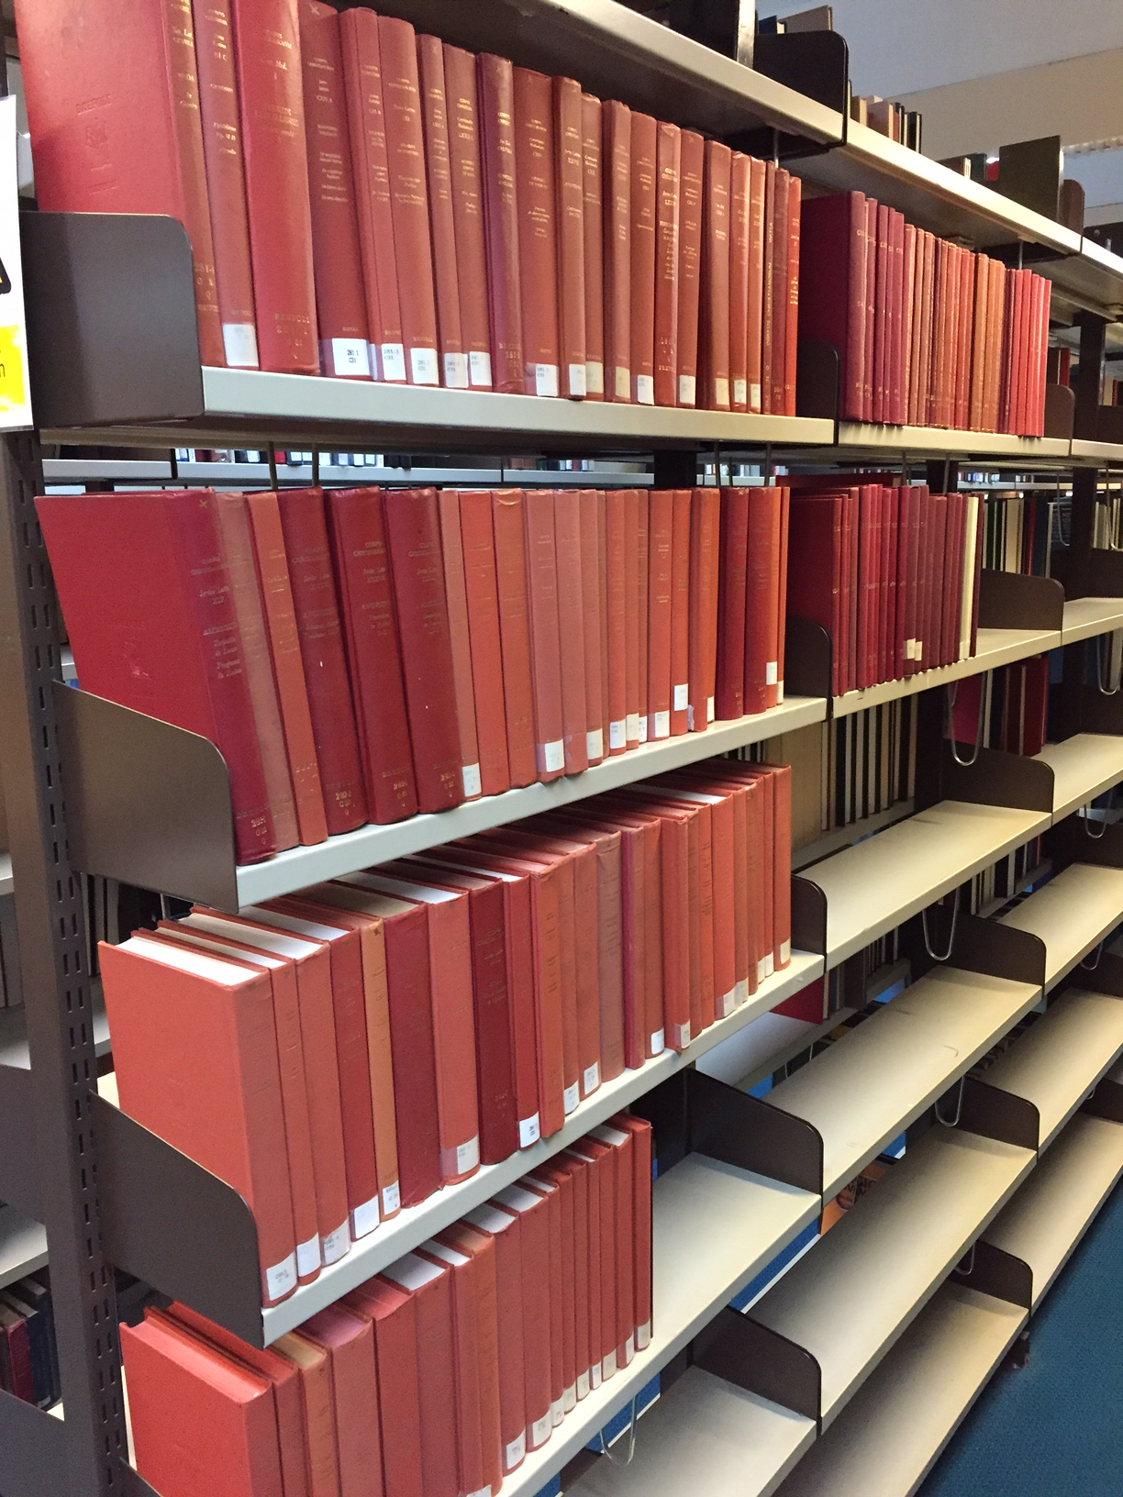

Slide 9
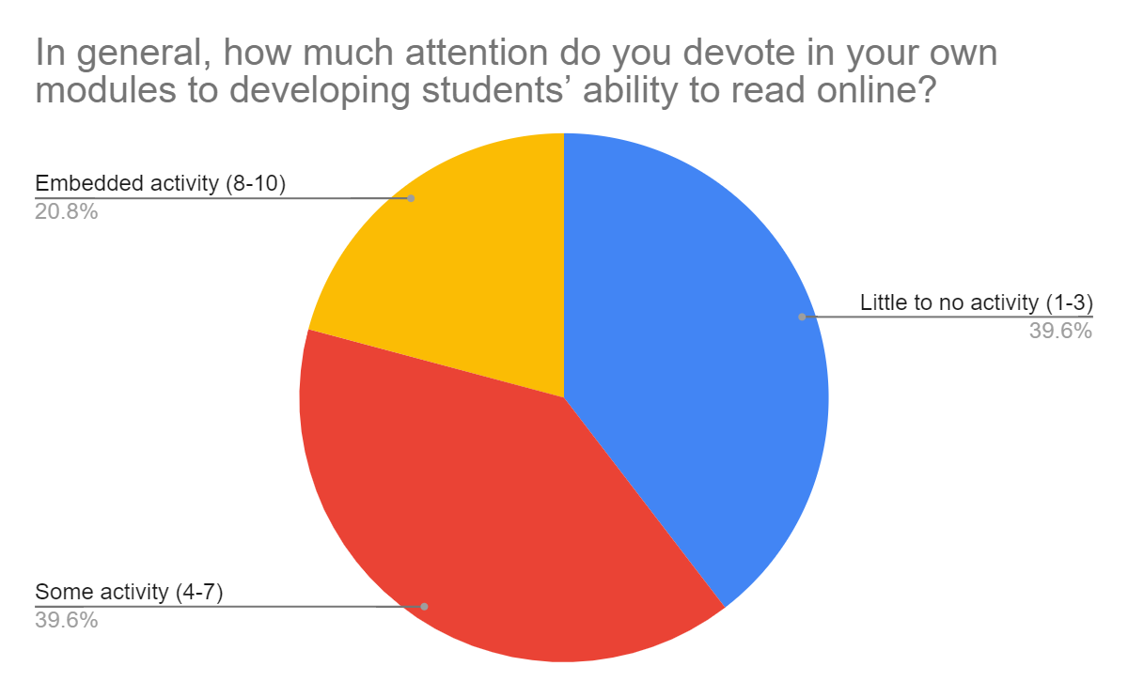

Slide 10
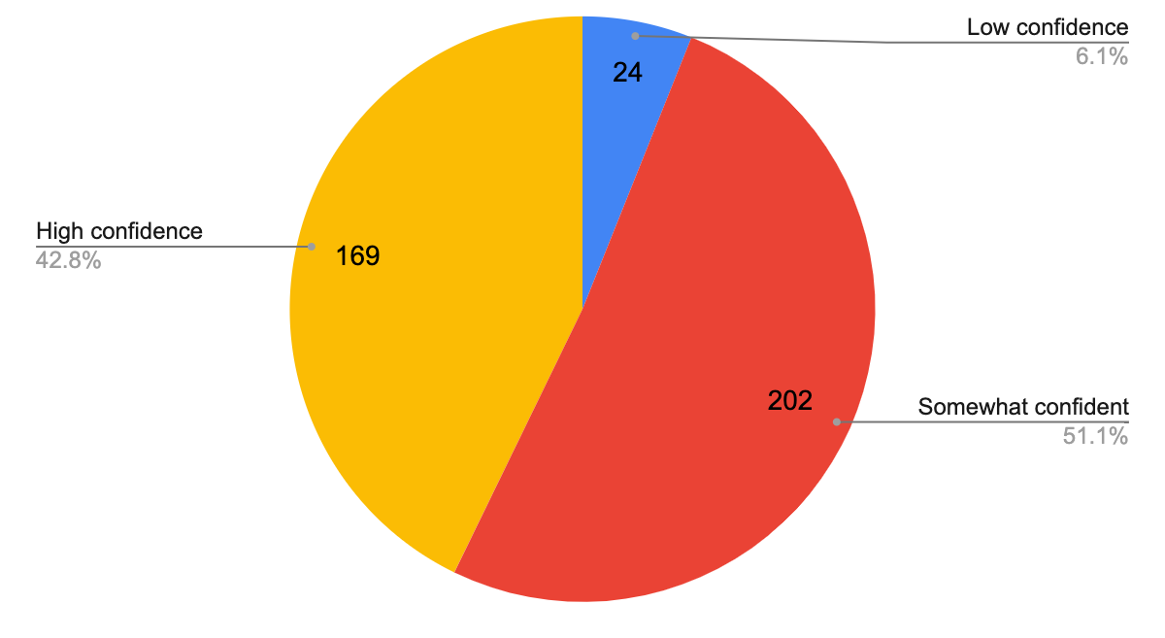
Student vs. staff ratings of skills
Student confidence in reading for studies (online and offline)
Staff ratings of students’ academic reading (online and offline)

Slide 11
First years’ confidence

Slide 12
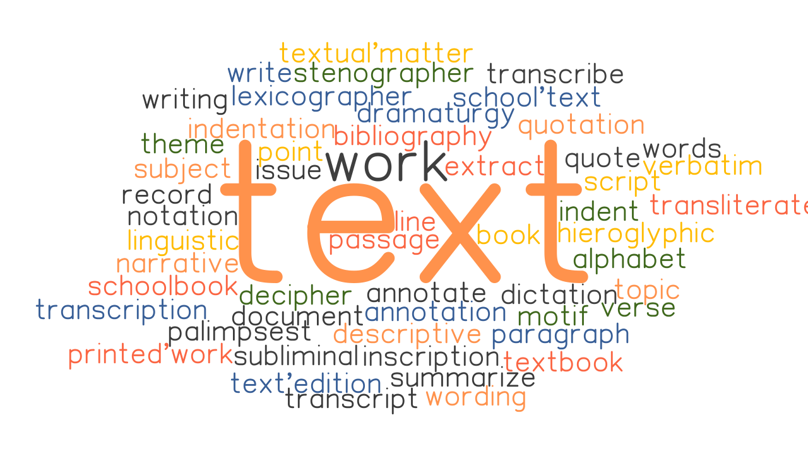
How do you encourage students to engage in reading (online and offline) in your discipline?
The text: Selection of appropriate mandatory reading, sometimes with scaffolding to support engagement
The pedagogy: teaching methods/ workshops/ in-class activities
The teacher: emphasising, verbally or in writing, the value and necessity of reading to achieve success

Slide 13
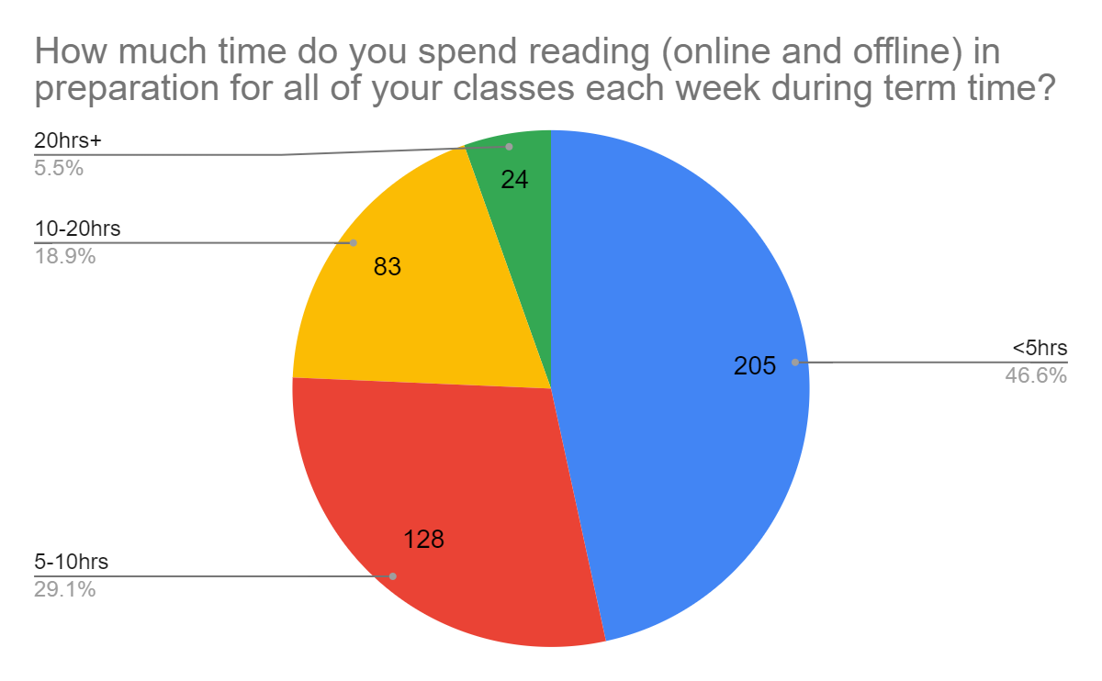
Reading = note-taking
Students use technology to access texts, whether or not reading takes place online or offline
Many students mention preferring hard copy, struggling physically to read online
Many mention reading while travelling

Slide 14
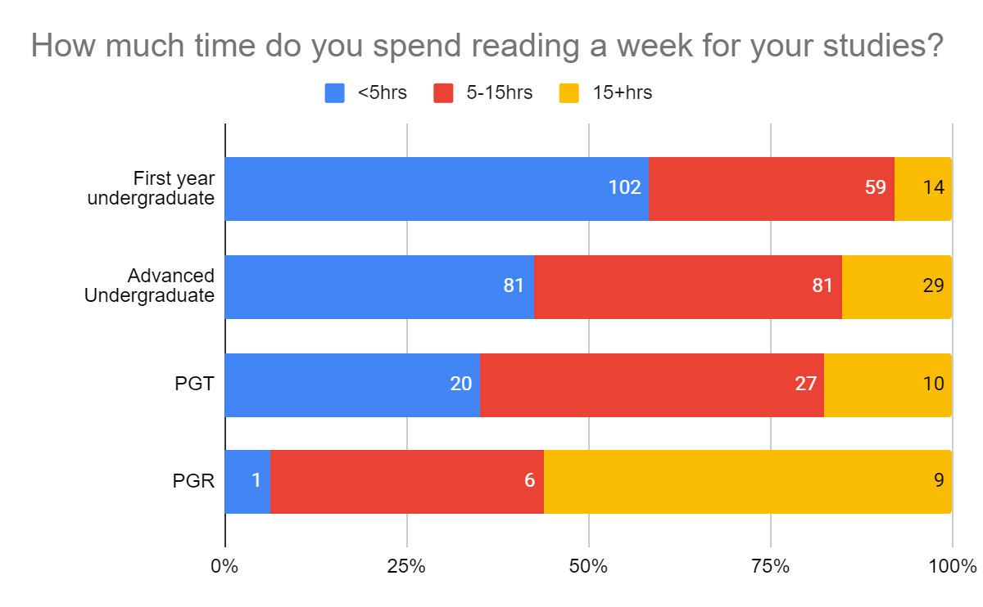
By level of study

Slide 15
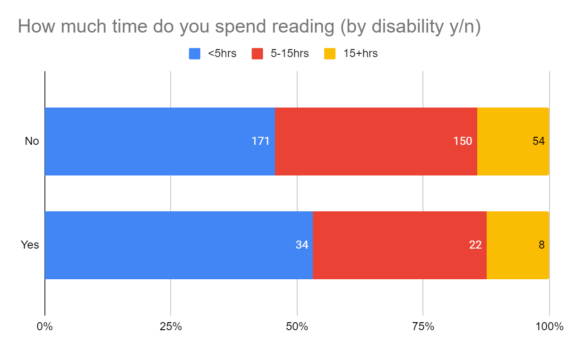
By disability

Slide 16
Student Q: Can you tell us a little bit about how you read for your study on a weekly basis?
Themes from L1 responses
Quotes from L1 students
Reading done in preparation for class rather than reviewing afterwards
Don’t alter reading methods, whereas L2/L3 students mention skim reading vs. deep reading, depending on task, e.g.:
‘I skim read the vast majority of texts, unless it's an important text (for assessments etc.).’ (Classical Studies, UK)
'[I] read more densely when preparing essays’ (History and Politics, UK)
Relying more on lecture notes and pre-recorded lecture material
More specific reference to set readings
Minimal reference to difficulty of reading
‘I write hand-written notes whilst reading predominantly online material; although online works are easier to access, I tend to engage better with a physical book if I have a copy, which unfortunately is rare.’ (History, UK)
‘I tend to print resources out if I can as reading online strains my eyes. But can't do this all the time.’ (English and History, UK)
'Do recommended background reading. Read lecture notes before lecture and look up unfamiliar terminology to be able to follow the lecture more easily.’ (Conservation, UK)
‘I find the reading too complex to understand’ (Fine Art, UK)

Slide 17
Advantages for L1 students
Accessibility and cost
‘Ease’ (access, use, locate)
Direct annotation a benefit
Technical skills and digital literacy
Preparedness in terms of skills and dispositions

Slide 18
Challenges of reading online for L1 students
Not knowing what to look for or how to look for it
Multiple, readily-available sources accessible through a range of platforms
Research skills and independent working
Similarities to L2/L3s:
concentration and distraction
headaches and eye strain
connection issues
lack of interaction with the text

Slide 19
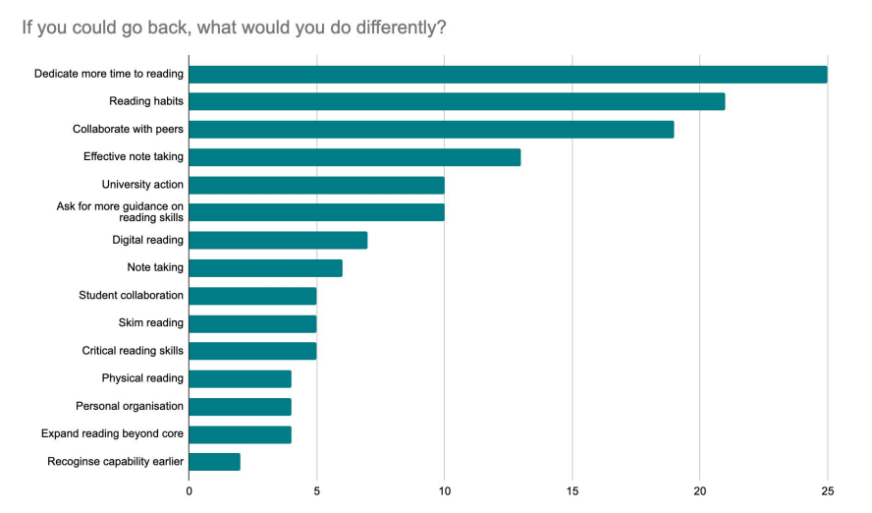
One thing I’d change

Slide 20
Summing up
Caveats
Conclusions
Pandemic effect
Humanities-heavy sample
Relationship to more general skills-related challenges
Relationship between online and offline reading
Expectations vs. reality
Required skills vs. taught skills
Distraction, physical challenges
Impact of collaborative reading and annotation
Transition
Disciplinary vs. generic reading skills
Where is the pedagogy for reading?

Slide 21
Thanks!
Twitter: @woodjamie99 and @MakDigHist
Project website: https://makingdigitalhistory.co.uk/read/active-online-reading/
Email: jwood@lincoln.ac.uk

