Slide 1
Engaging Students in Active Reading: Lessons from History and Heritage at Lincoln
Dr Jamie Wood, Professor of History and Education

Slide 2
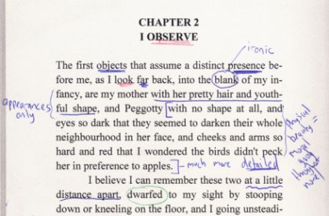
Today
Active Online Reading project
Practice: my experiences and practices in History & Heritage
Reflections: what we’ve learnt in History at Lincoln

Slide 3
1. Active online reading
QAA-funded collaborative enhancement project
April 2021-May 2022
Community of practice in History
Other disciplines (Design and Business)
Survey of staff and students: 500+ responses
Student researchers: reflective blog posts and data analysis
Project website: https://makingdigitalhistory.co.uk/read/active-online-reading/

Slide 4
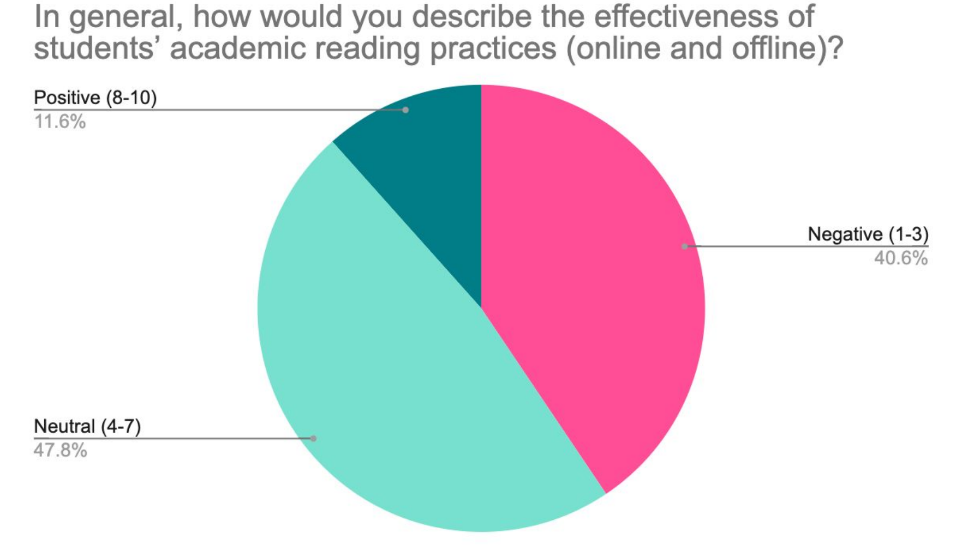
Students’ reading (according to staff)
Deficit understanding
Students not understanding texts and arguments
Using the wrong tactics: surface over deep reading
Relationship to general study habits/ skills
Intrinsic motivation key – a lack of initiative
Transition critical, though improvement over time
Digital distraction - social media perceived to have a negative impact

Slide 5
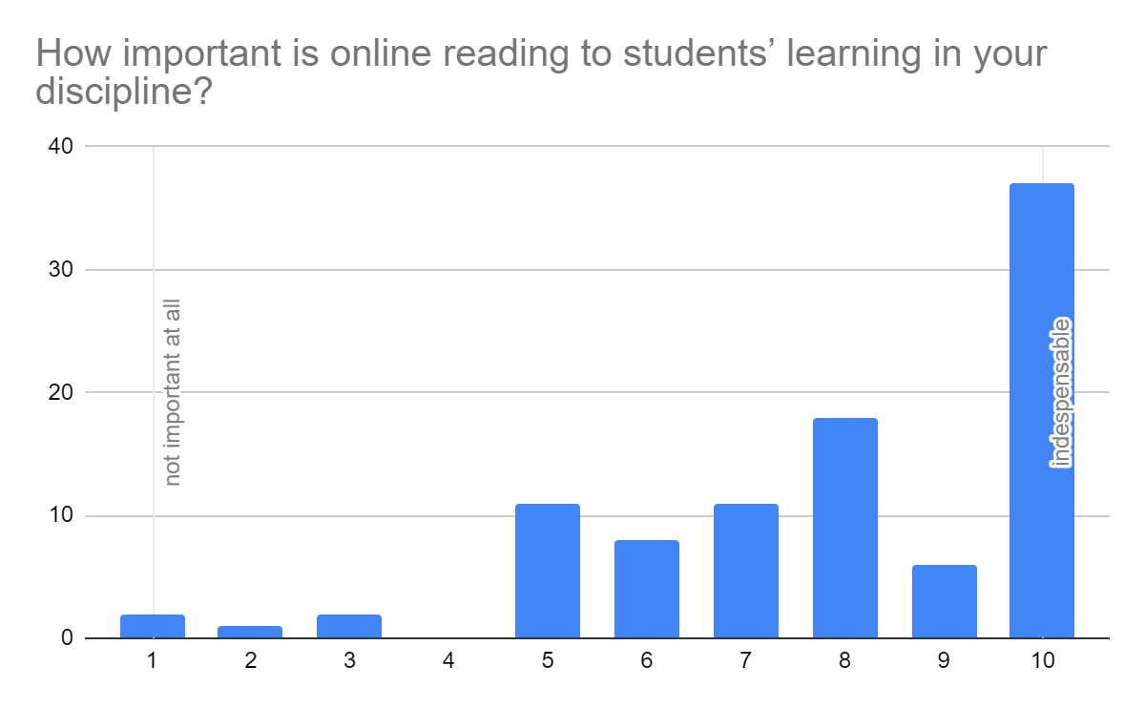
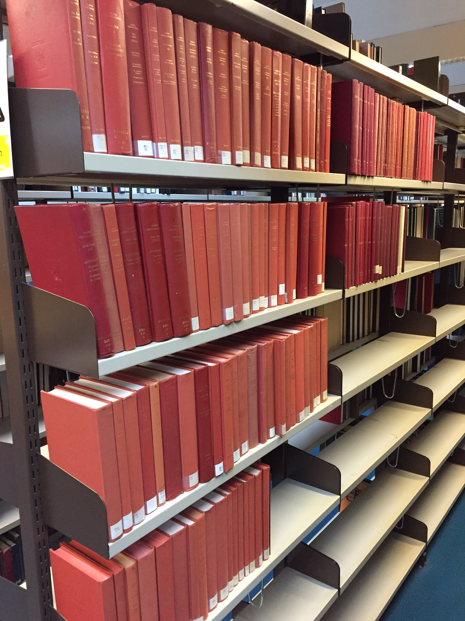

Slide 6
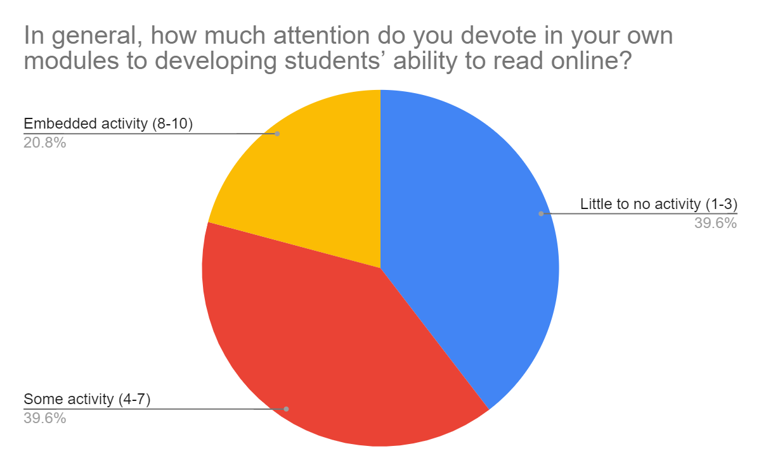

Slide 7
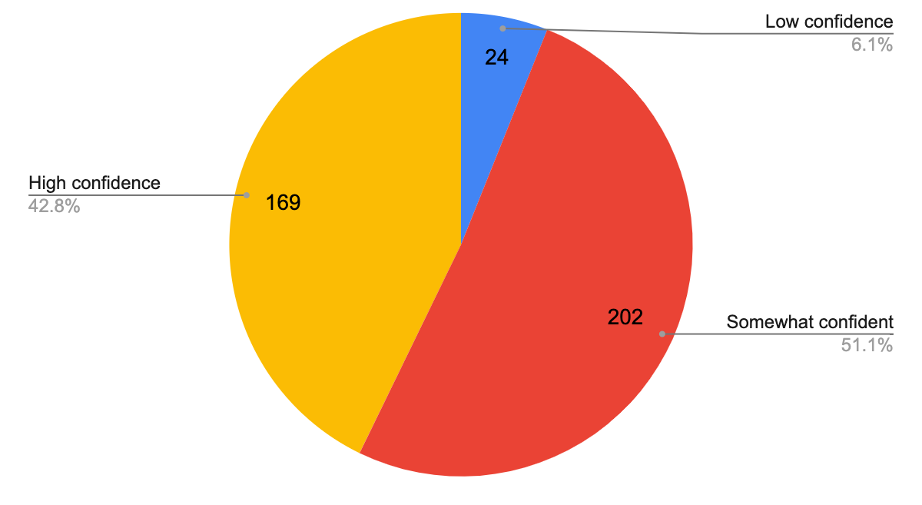
Student vs. staff ratings of skills
Student confidence in reading for studies (online and offline)
Staff ratings of students’ academic reading (online and offline)

Slide 8
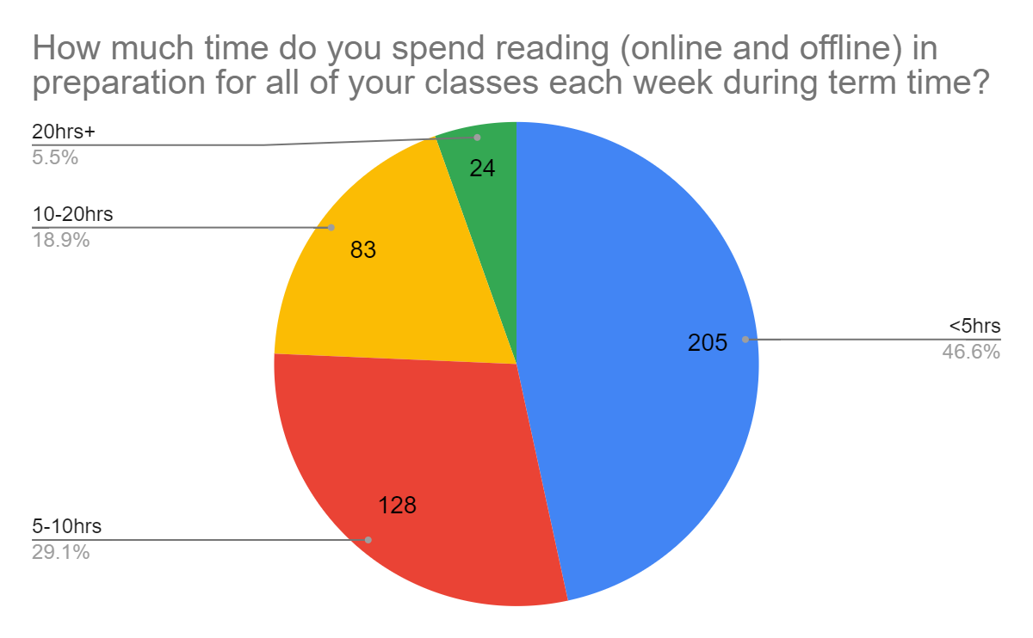

Slide 9
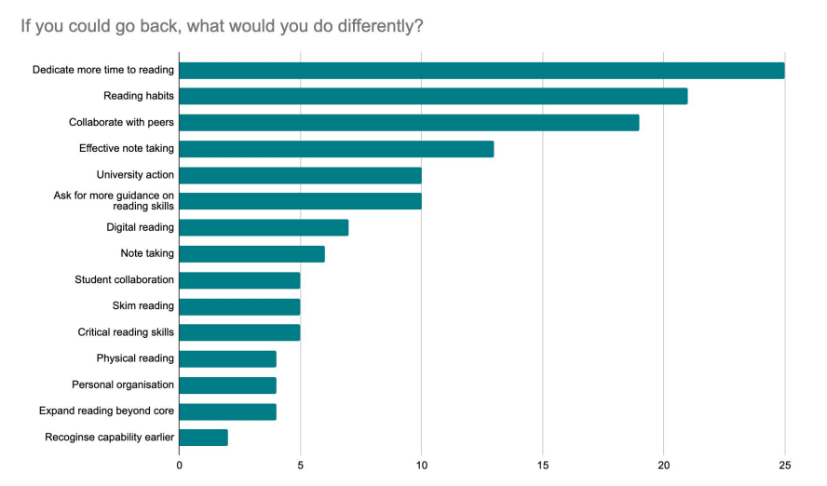
One thing I’d change
“I think I would be less obsessive with my reading practices - I've come to realise that it's ok not to write everything down, or get every piece of information. This change would definitely have made my reading experience far, far less stressful.”
Student: Sheffield Hallam University
“I think it’s important to stay on top of reading. Definitely very important to be prepared. I think I would change my imersiveness with the reading. Maybe try and read more physical books instead of constantly online.”
Philosophy student: Monash University

Slide 10
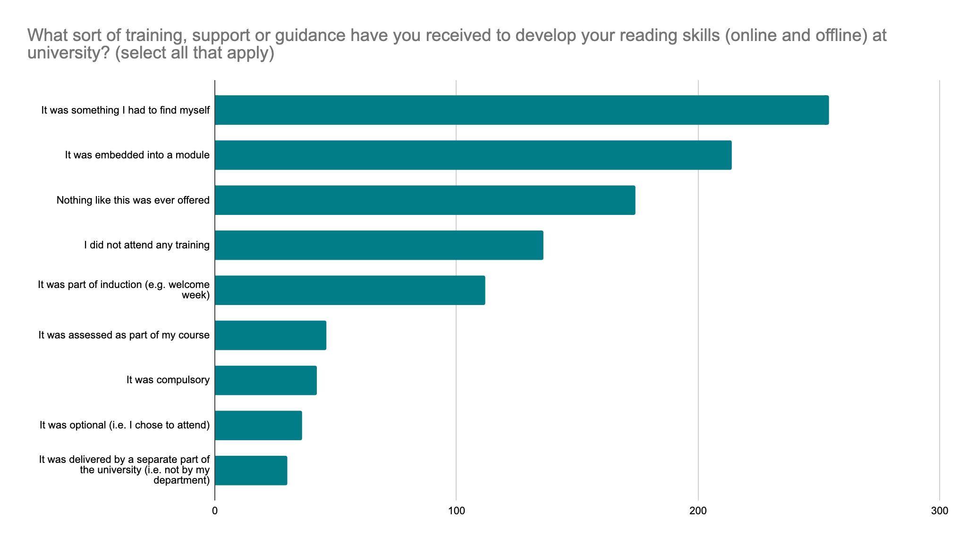
Student awareness of support

Slide 11
2. My experience: the challenge of getting students to read (well)
At first: why don’t (many of) the students do the reading?
Then: why don’t (many of) the students think about the reading?
Maybe there’s too much of it? So, I set less.
Maybe they don’t know how to engage with it? So, I added more structure to preparatory and in-class activities.
Maybe they need extra motivation? So, I assessed their contributions.
The real problem: How can we help students to process readings more effectively?

Slide 12
Getting my students reading
2018: adoption of Talis Elevate for new L3 UG module, Making Militants (= design stage)
TE: an elegant solution than before
Setup time short
Integration with library systems, engagement with academic readings
Annotation and interaction occur in one space (fewer clicks)
Approach:
Minimal direct intervention by tutor – a student space
Student comments directly inform classroom activities
2020-21: introduction of shared MS 365 documents for ‘classroom’ annotation

Slide 13
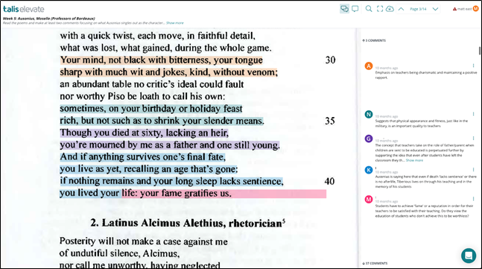
Weekly activity (= 15% of overall grade)
Students required to post 2-3 online comments on weekly reading(s)
Points of interest
Questions
How materials (and weeks) inter-relate
Informed/ structured seminars
Created a knowledge bank for the cohort (and for assessments)

Slide 14
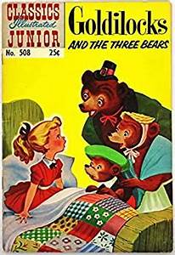
What happened
Outcomes:
Very high levels of engagement, but on a sliding scale
And even highly engaged/ high achieving students can become anxious
Positive feedback from students
Learning from each other; different perspectives/ interpretations
Shared knowledge bank to return to later
Integration of ‘homework’ and in-class activity
Observations
Relatively low risk: low input, high reward
Over three years: putting annotation (as an output of collective reading) at the heart of all activity
In my experience, Elevate works well for:
Close reading of texts
Asynchronous, preparatory activities
Open-ended reading

Slide 15
Student feedback
“Everyone is able to contribute and has background knowledge for the week’s topic at a minimum. If the reading isn’t understood then there are comments available to offer an explanation of certain things.” (survey)
“seems more organic (and safer? less awkward at least) than in the seminar room. Being able to attach a comment directly to a piece of the text as you read it makes it easier to open a discussion and highlight points of confusion.” (survey)

Slide 16
Other approaches to using Elevate in History and Heritage
Large, core modules: preparatory worksheets in Elevate for seminar groups, with questions and sources
In-class, ‘live’ annotation of sources to share results of groupwork
Image annotation for visual/ material culture classes (e.g. Art History/ Archaeology)
For assessment: student independently commenting on a source by adding annotations

Slide 17
Wider observations
Many students value the opportunity to annotate collaboratively to develop their understanding of readings (AOR survey and in my experience)
Close reading – core skill in History
Assessment rewards the students for the work they have actually done
Embed the tool rather than bolting it on
Points of intersection with other tools/ ‘classroom’ sessions
Communication is key: what are students expected to do, and why are they being asked to do it?

Slide 18
Reflections
Processing the reading is vital – encourage activity
Frequent, micro-level engagement works well
Framing – low input/ risk, some reward
Many students like reading together
Modelling of disciplinary skills/ processes

