Slide 1
Active Online Reading: key findings and next steps
Talis TLCR – November 2022
Prof. Jamie Wood, University of Lincoln
Project report: https://bit.ly/3ApbmWc
Project website: https://bit.ly/3XqMLun

Slide 2
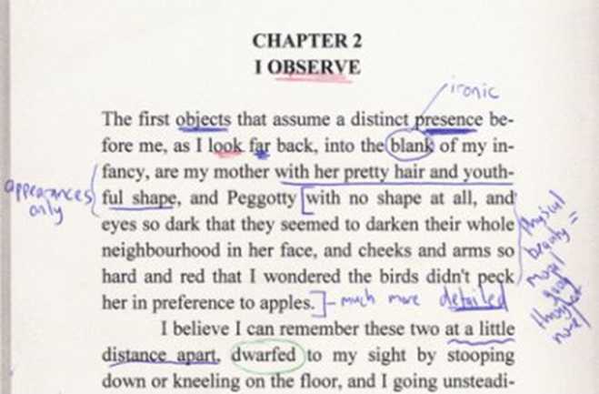
Introduction
The project
Key findings
Experiences
Pedagogies
Resources
Next steps

Slide 3
Active online reading project
QAA-funded Collaborative Enhancement Project
April 2021-April 2022
Community of practice in History
Broadening to other disciplines
Students-as-partners

Slide 4
Method
Workshops
Reflective blogs
Literature reviews
Case studies
Pedagogic resources
Surveys of staff and students

Slide 5
Survey (November 2021-January 2022)
Student survey: 442 responses
15% self-identified as having a disability that affects their ability to read
Staff survey: 98 responses
10 countries
50+ institutions

Slide 6
Findings: experiences

Slide 7
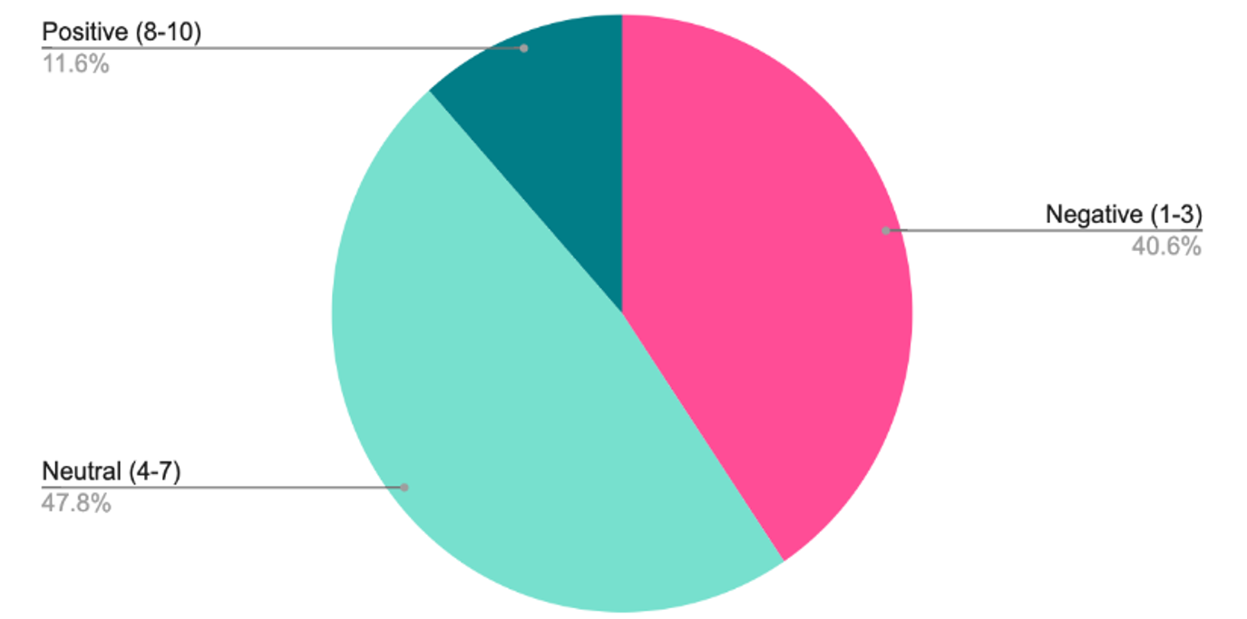
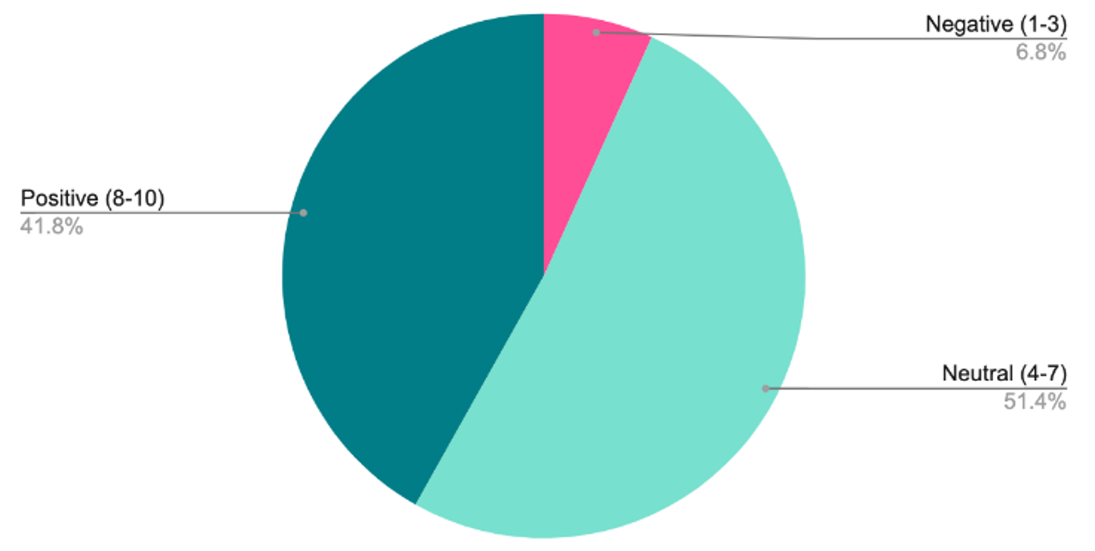
Disjunctions
Staff rating of student capability in online reading
Student self-rating of confidence in online reading
I outline the set reading for the following week at the end of the seminar, and email again midway through the week to remind them. For broader, curiosity-driven reading outside of summative assessments, I confess I don't see much evidence.’ (UK academic)

Slide 8
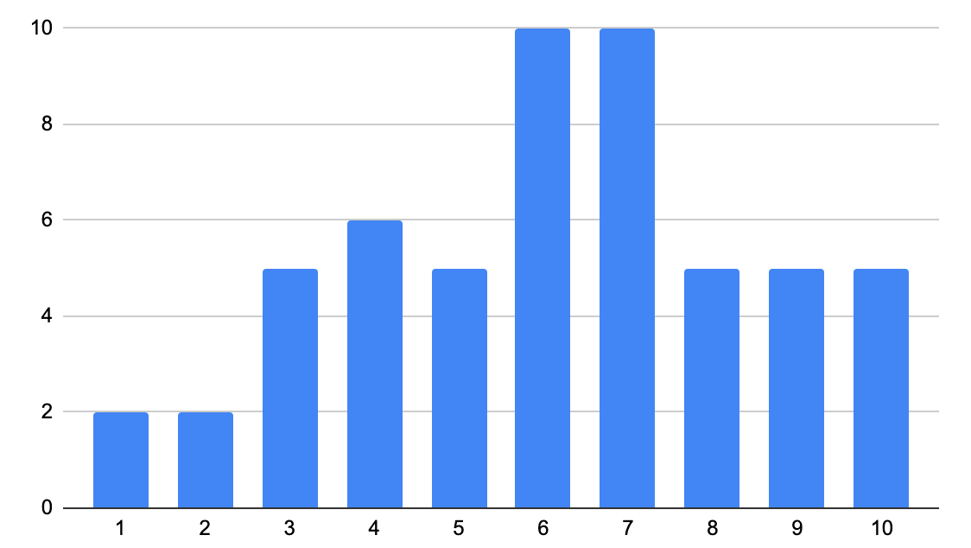
First years
No disability (overall)
Disability (overall)

Slide 9
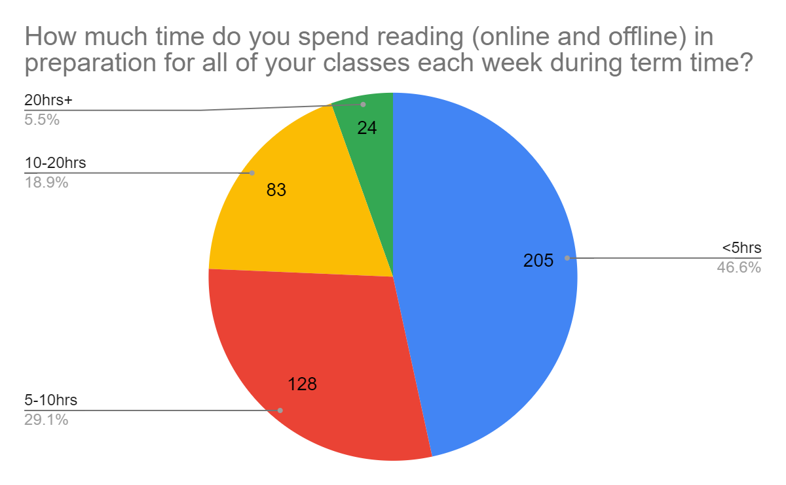
Reading = note-taking
Students use technology to access texts, whether or not reading takes place online or offline
Many students mention preferring hard copy, struggling with eye strain
Other physical side-effects mentioned repeatedly (backache, headache)
Many mention reading while travelling

Slide 10
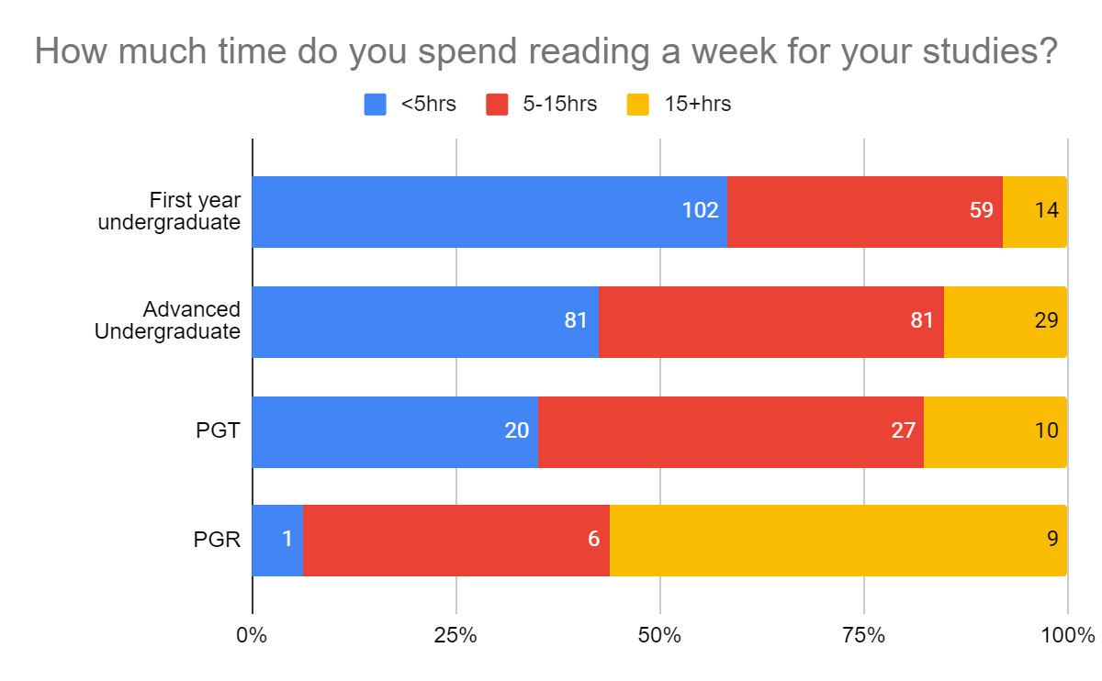
By level of study

Slide 11
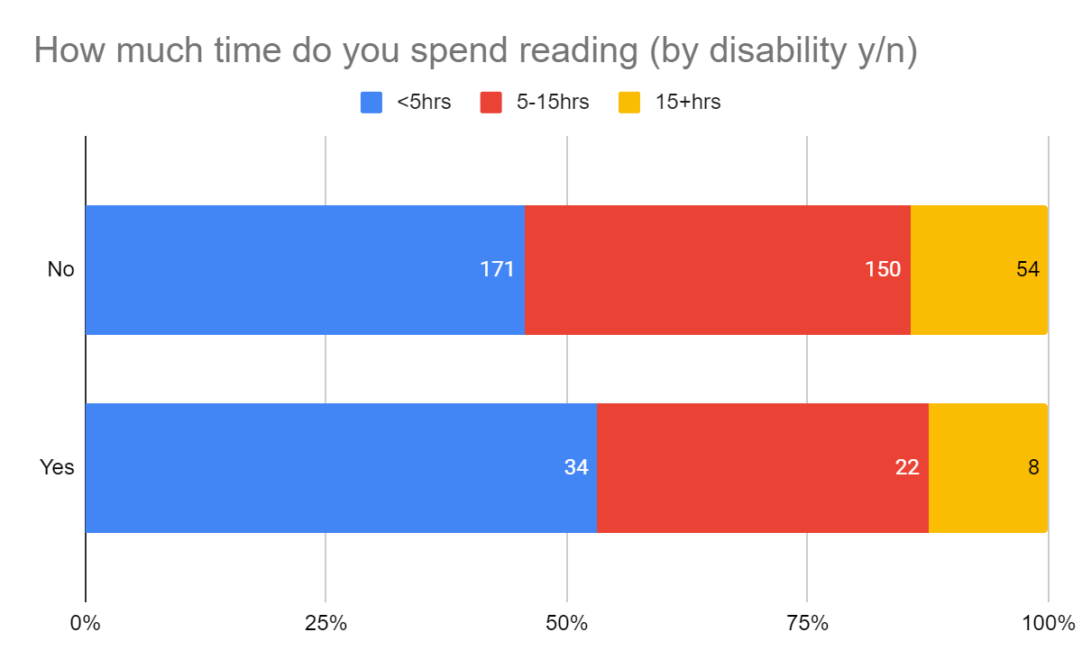
By disability

Slide 12
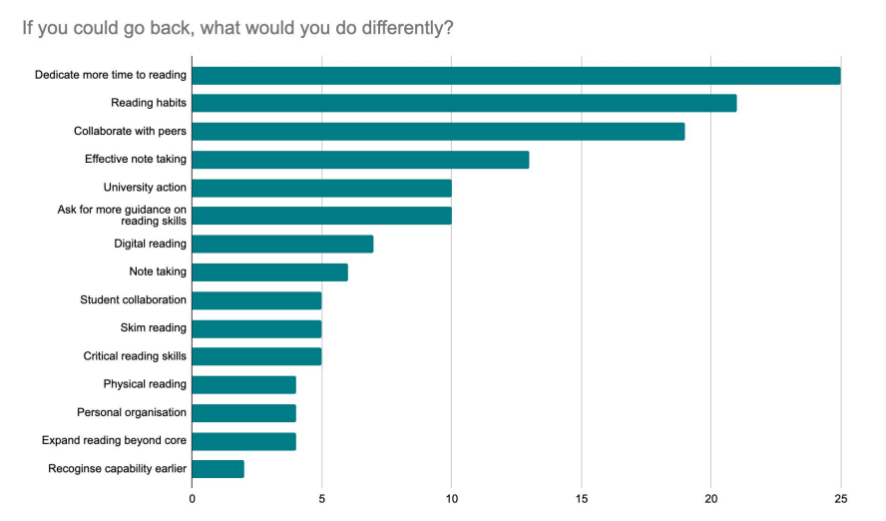
One thing I’d change

Slide 13
Findings: Pedagogies

Slide 14
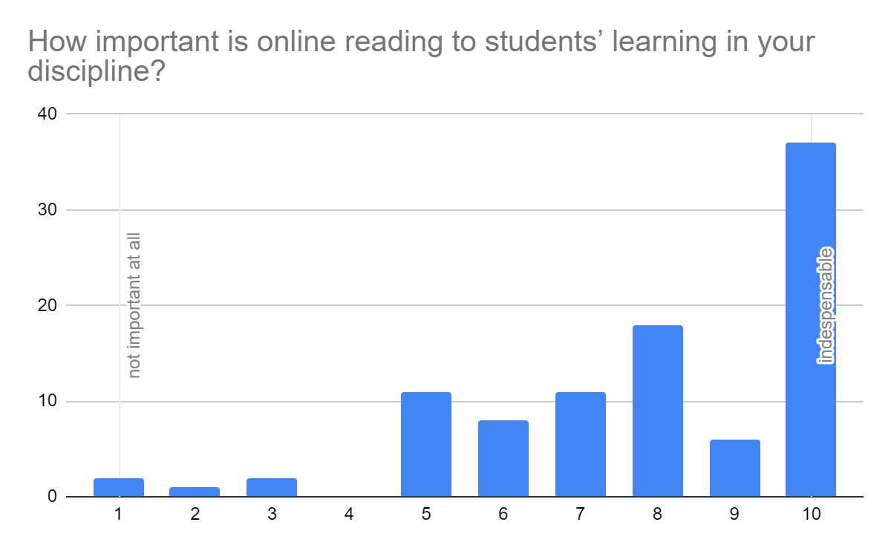
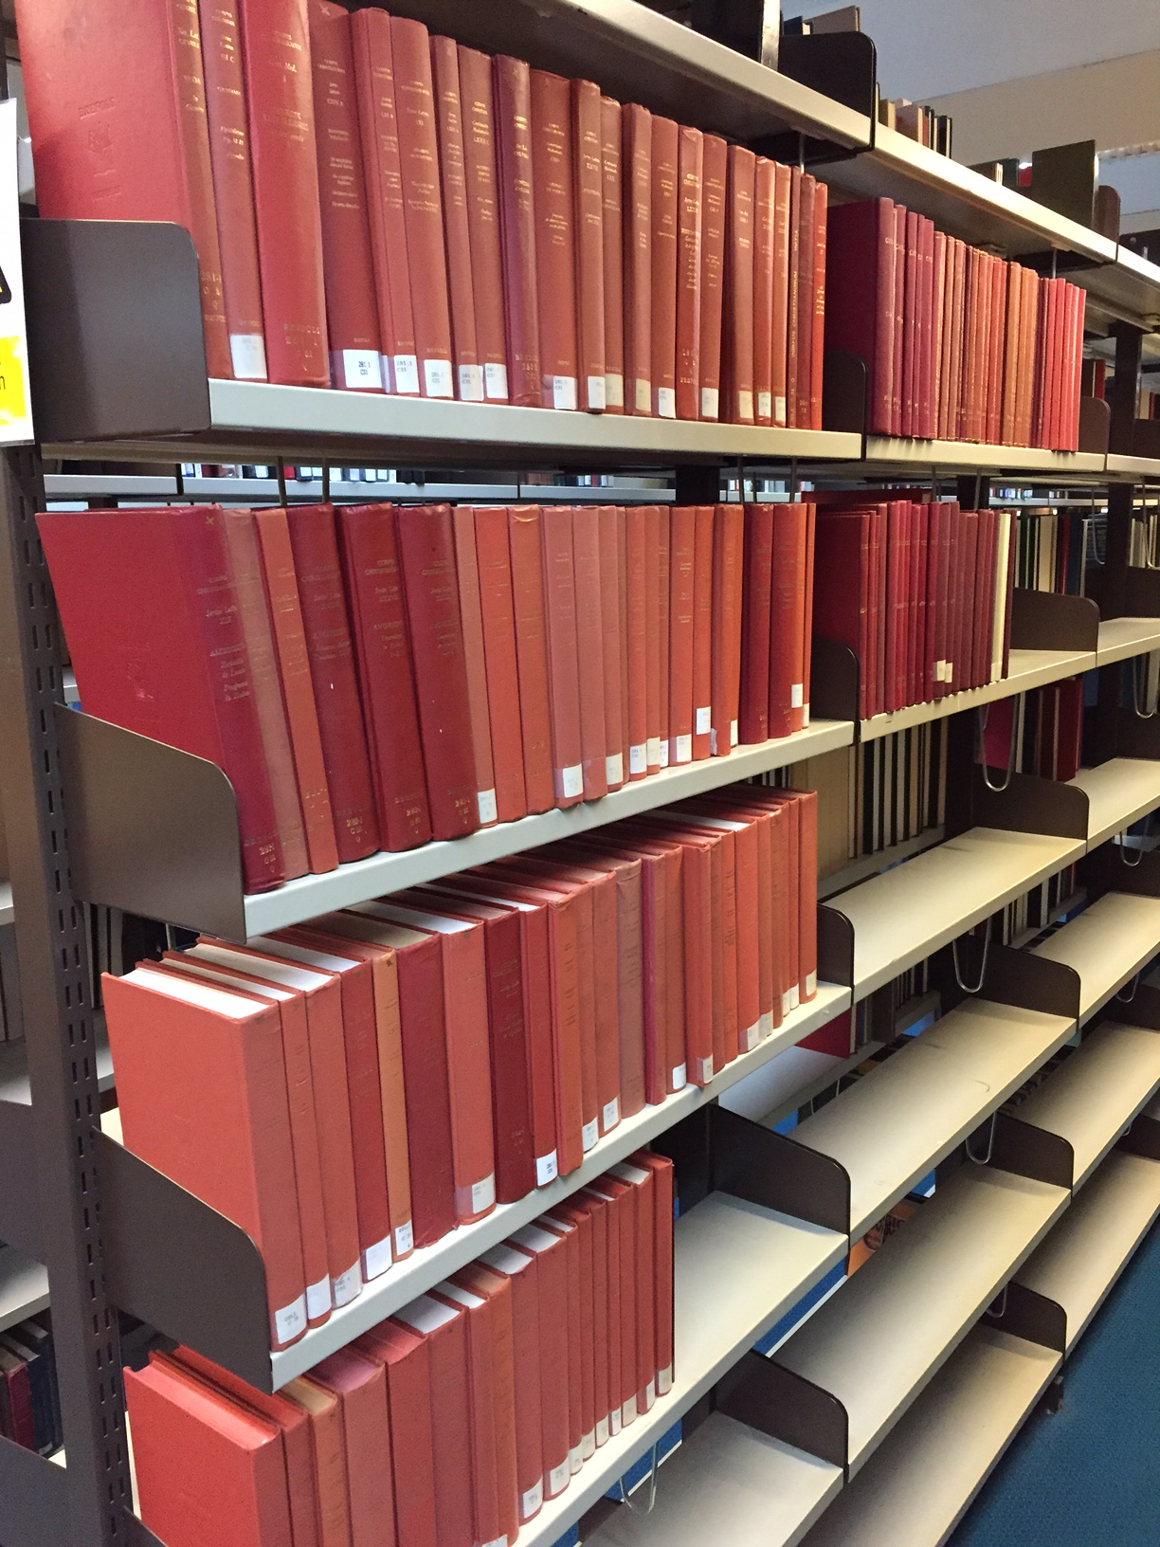

Slide 15
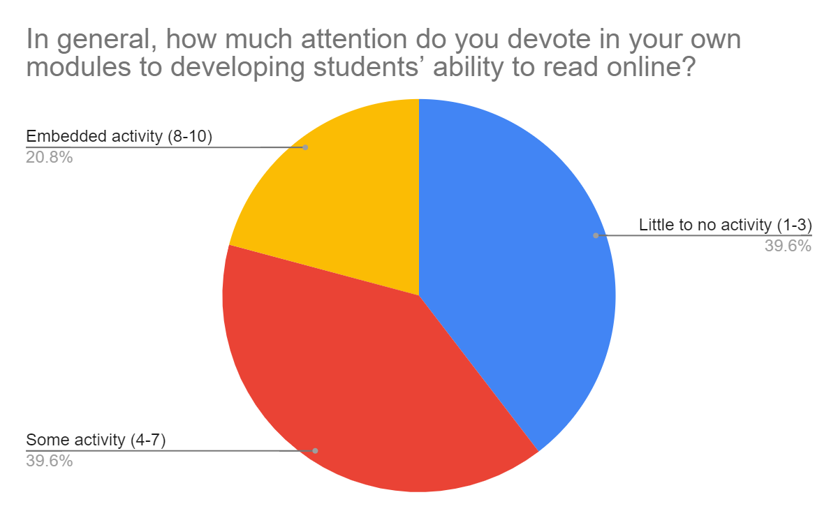

Slide 16
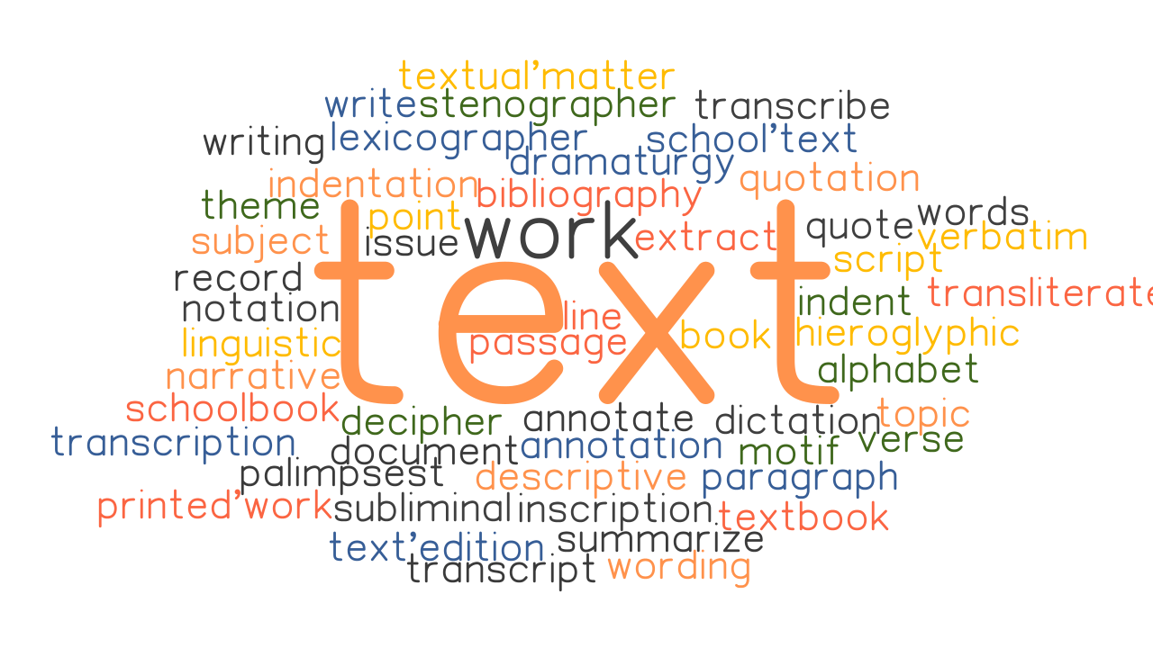
How do you encourage students to engage in reading (online and offline) in your discipline?
The text: Selection of appropriate mandatory reading, sometimes with scaffolding to support engagement
The pedagogy: teaching methods/ workshops/ in-class activities
The teacher: emphasising, verbally or in writing, the value and necessity of reading to achieve success

Slide 18
‘I think it would have been very helpful if there was a programme or module designed to help us with our own reading practices in the first year, because without that help, we often develop bad and unhealthy reading habits that lead to frustration and dissatisfaction with the practice of learning.’

Slide 19
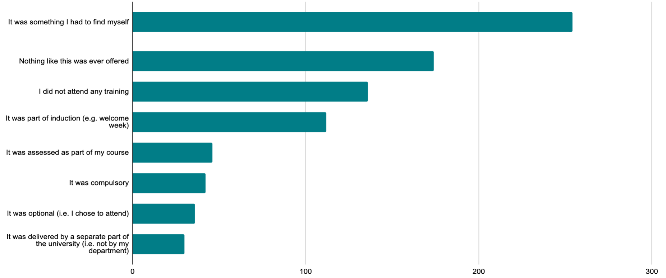
Accessibility
Students and staff rated ‘accessibility’ as perhaps the key benefit of online reading
Cost
Flexibility
Ease of access and use
For reading, this also extends to selection of materials in terms of length, level of difficulty, appropriateness
Timing
Placement within the curriculum
Student responses to a question on the sorts of support that was available for supporting their reading skills development

Slide 20
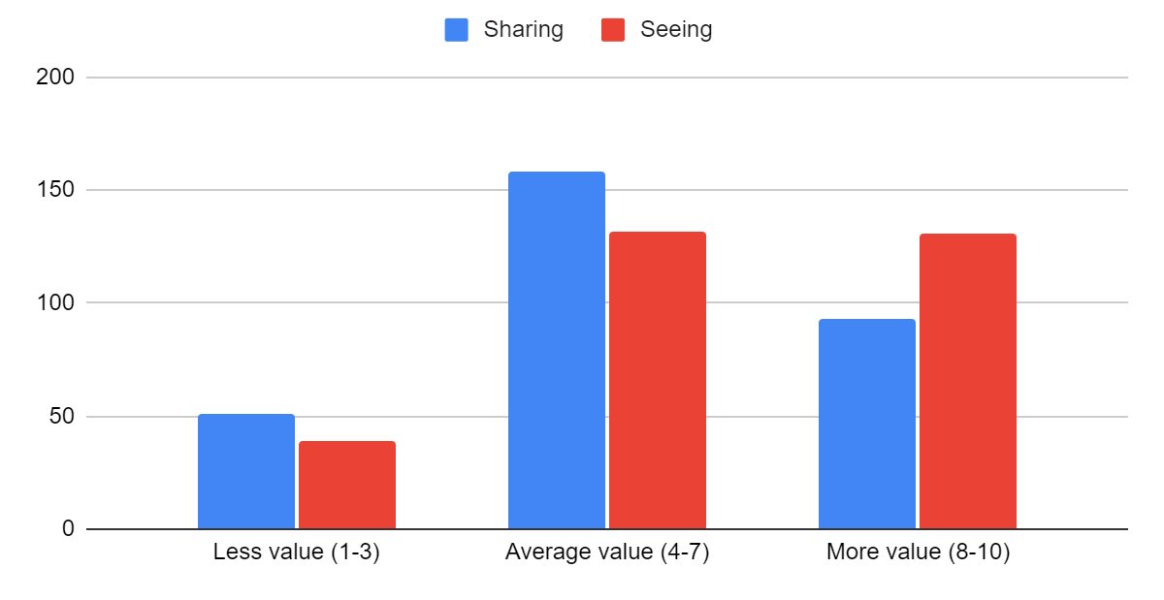
How useful is it to share your thoughts about online reading with your fellow students? How useful is it to hear or see what your fellow students think about what they have read online?

Slide 21
Usefulness of sharing thoughts on readings and seeing those of others
Collaborative reading a significant aid to understanding
Discussion improves confidence, making students feel ‘validated and verified’ by peers
Diversity of opinion deepens understanding and engagement with the reading: ‘forces me to evaluate my opinions’
Engagement with peers enables sharing and development of skills
Social benefits

Slide 22
Resources

Slide 23
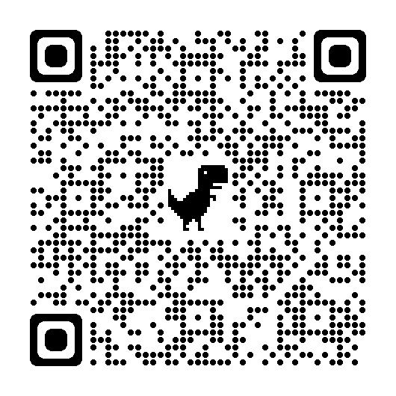
Pedagogic materials

Slide 24
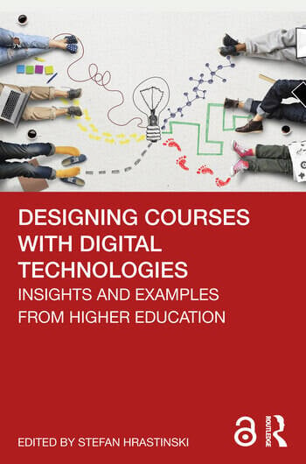
Scholarship
Blog posts
Case studies
Conferences
Publications
M. East, H. Williard and J. Wood, Collaborative Annotation to Support Students’ Online Reading Skills, in. S. Hrastinski, ed., Designing Courses with Digital Technologies: Insights and Examples from Higher Education (New York: Routledge, 2022), pp. 66-71.
J. Chandler, G. Barrett, J. Wood, M. East, Promoting Active Engagement with Text-Based Resources in Large First-Year Modules in History, in A. M. Farrell and A. Logan, eds., Pedagogy for Higher Education Large Classes (PHELC) [Proceedings of the Fourth PHELC Symposium Hybrid Event, 10th June 2022 Dublin City University and Online] (Dublin: Dublin City University, 2022), pp. 40-44.
M. East, L. Warriner-Wood and J. Wood, Reading online during lockdown: insights from History and Heritage, in M. G. Jamil and D. Morley, eds., Agile Learning Environments amid Disruption: Evaluating Academic innovations in Higher Education during Covid-19 (London: Palgrave-Macmillan, 2021).

Slide 25
Conclusions and next steps
Reading and the rest
Distraction, physical challenges
Expectation management: meeting students where they are
The curriculum: transition, structure, progression
Potential of collaborative reading and annotation
Disciplinary skills and pedagogies
Online-specific pedagogies
https://bit.ly/3tHkrGk

Slide 26
Thanks!
Twitter: @woodjamie99 and @MakDigHist
Project website: https://makingdigitalhistory.co.uk/read/active-online-reading/
Email: jwood@lincoln.ac.uk

