Slide 1
Lincoln Conference
Three forms of Reading
Dr Sam Koon
Haileybury 15/5/23

Slide 2
Three Forms of Reading I want my students to do
Individual Extensive Reading
Group Extensive Reading
Group Intensive Reading

Slide 3
Individual Extensive Reading
Parallel Plus and Bellerophon

Slide 4
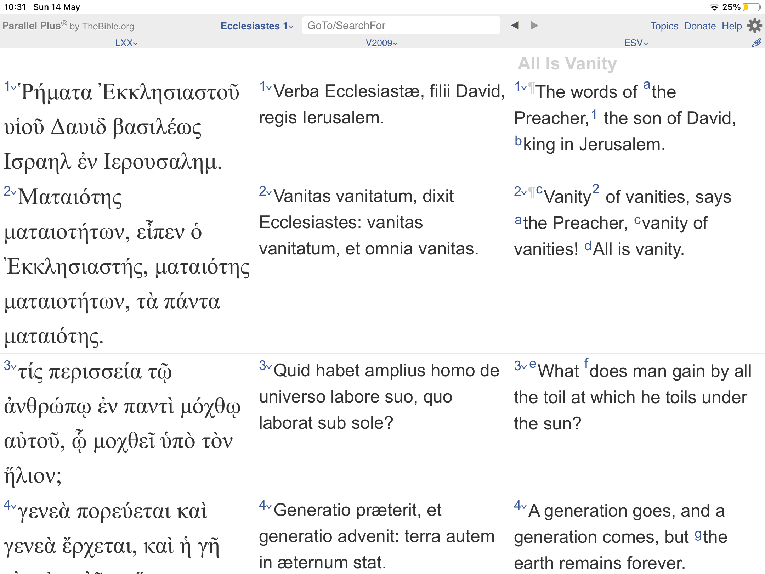
Parallel Plus
Free app
Only the Old and New testament
But, upto 6 parallel versions at once
HUGE number of languages and versions
Great for teaching Greek through Latin

Slide 5
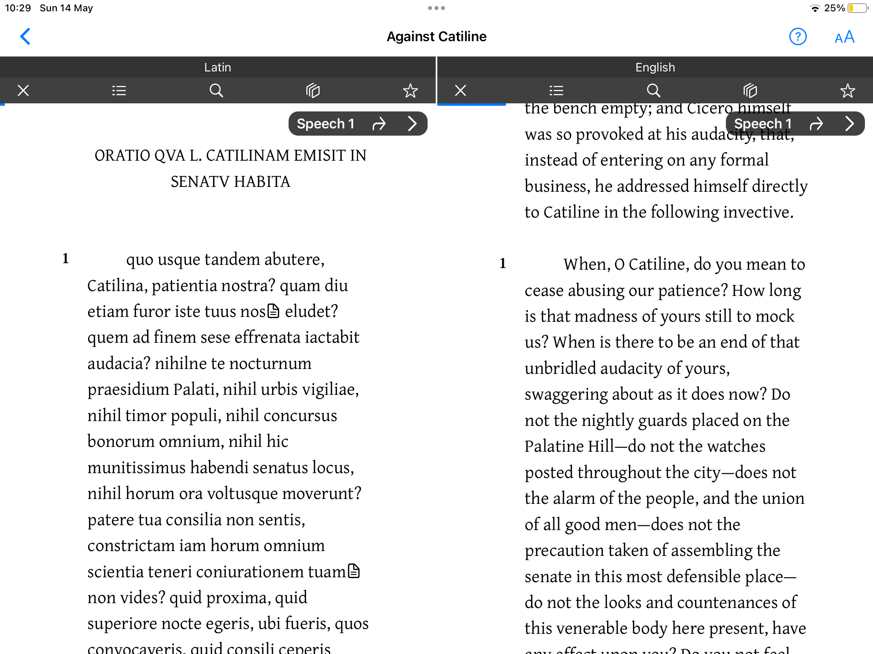
Bellerophon
Free app
HUGE library of Latin, Greek and Hebrew texts
Up to 4 texts on a screen at once
Can be used like Loeb BUT lots more texts, used without wifi and free

Slide 6
Group Extensive Reading
Interlinear translations

Slide 7
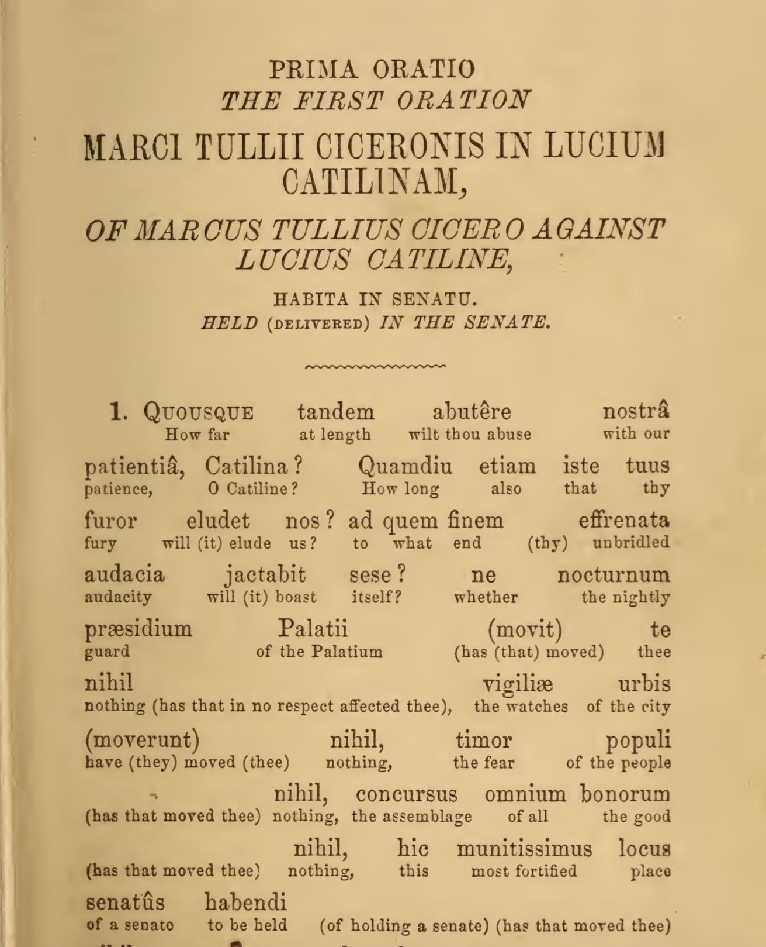
Hamiltonian Translations
Some available on archive/Google books
(Cicero, Virgil, Sallust, Caesar, Homer)
Breaks the original order and follows English prose order
Very easy to read extensively and quickly
Gloss below each word means no dictionaries and acts as a form of individual differentiation
Negative? Not the original word order

Slide 8
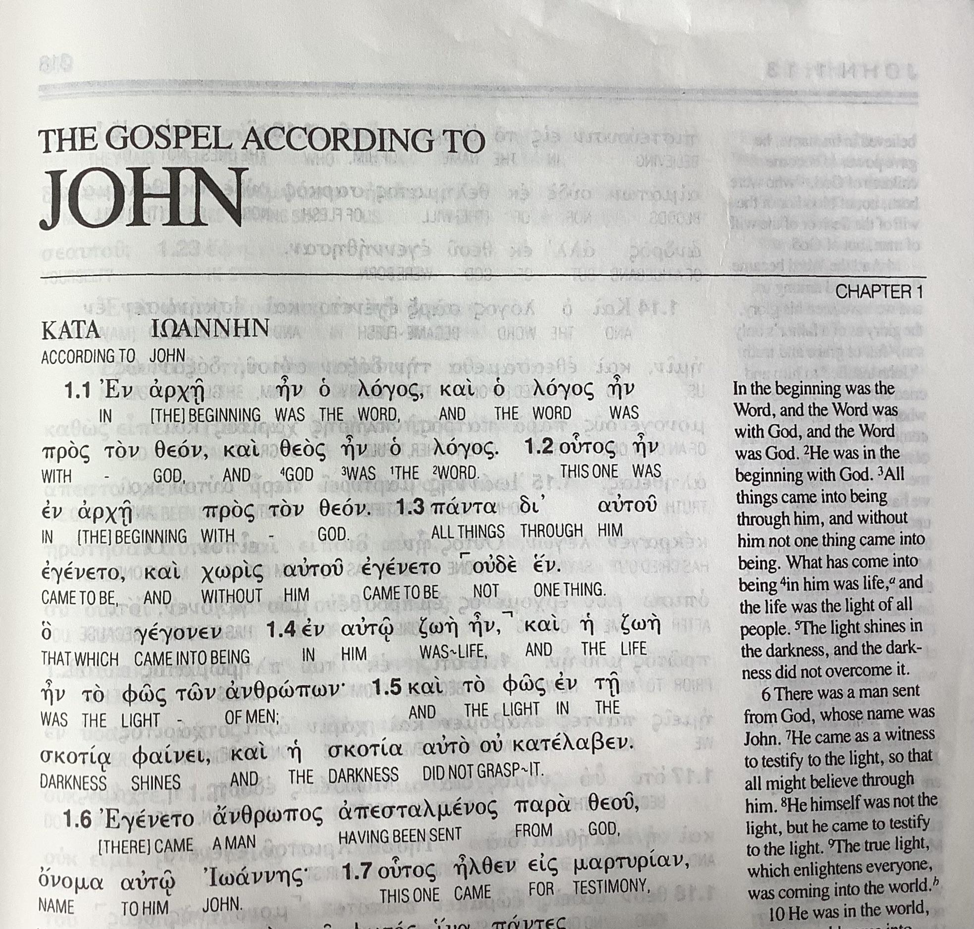
‘Scriptural‘ Interlinears
Keeps the original word order and simply glosses each word
Freely available in print for scriptural texts
Works well for works with relatively simple syntax - e.g. Homer, Eutropius, Res Gestae, etc
We need MUCH more of these
They mean our pupils can read original texts widely and at great speed

Slide 9
Iliad 1.1-7
Made by my colleague Dr Patrick James
Used successfully with 12 year olds in Year 8!

Slide 10
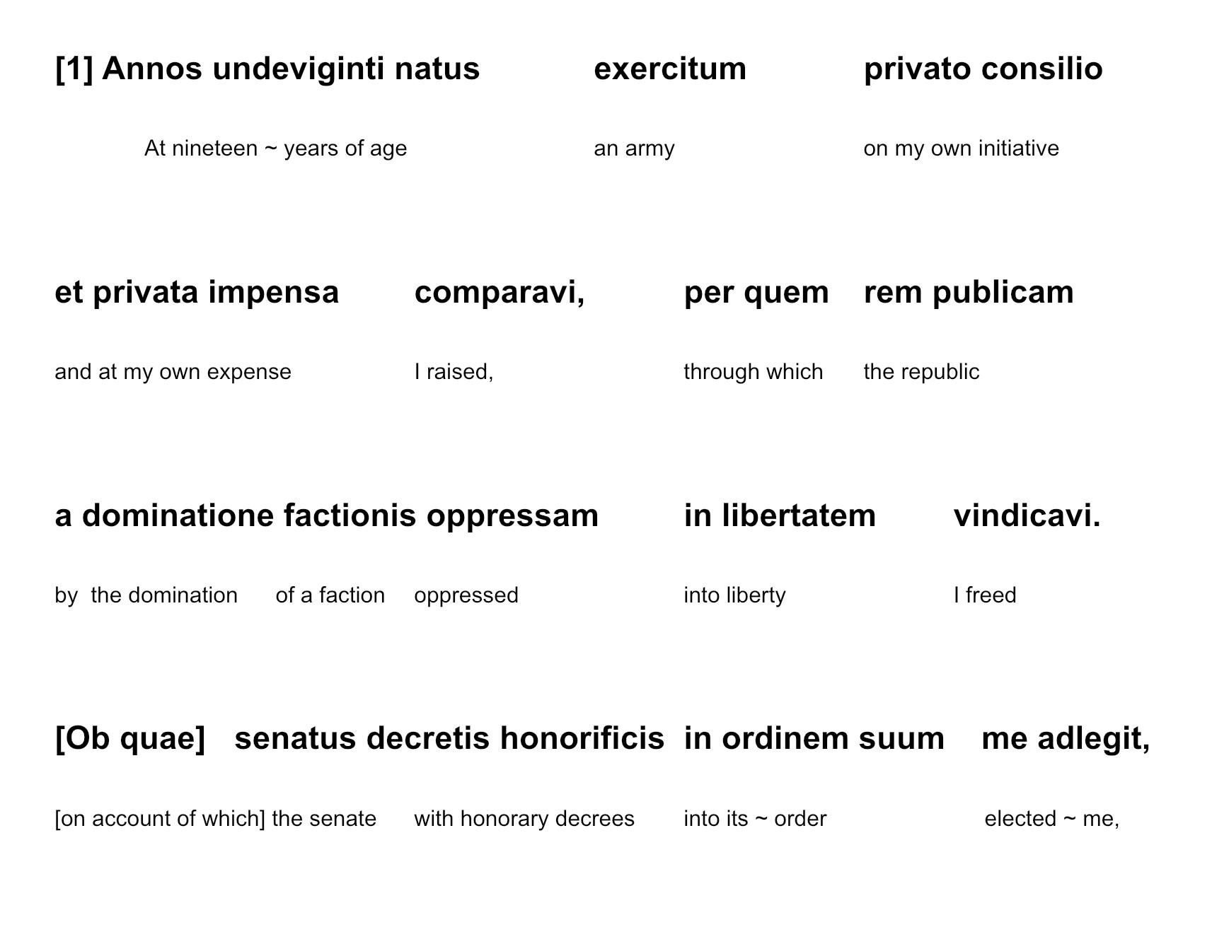
Res Gestae 1
Made by me
Used successfully with 16 year olds in Y11
I have the first 10 chapters and aim to do the whole text at some point
We need much more of these and to find a publisher willing to make a series of these
It would democratise Classical scholarship

Slide 11
Group Intensive Reading
Tiered Readers

Slide 12
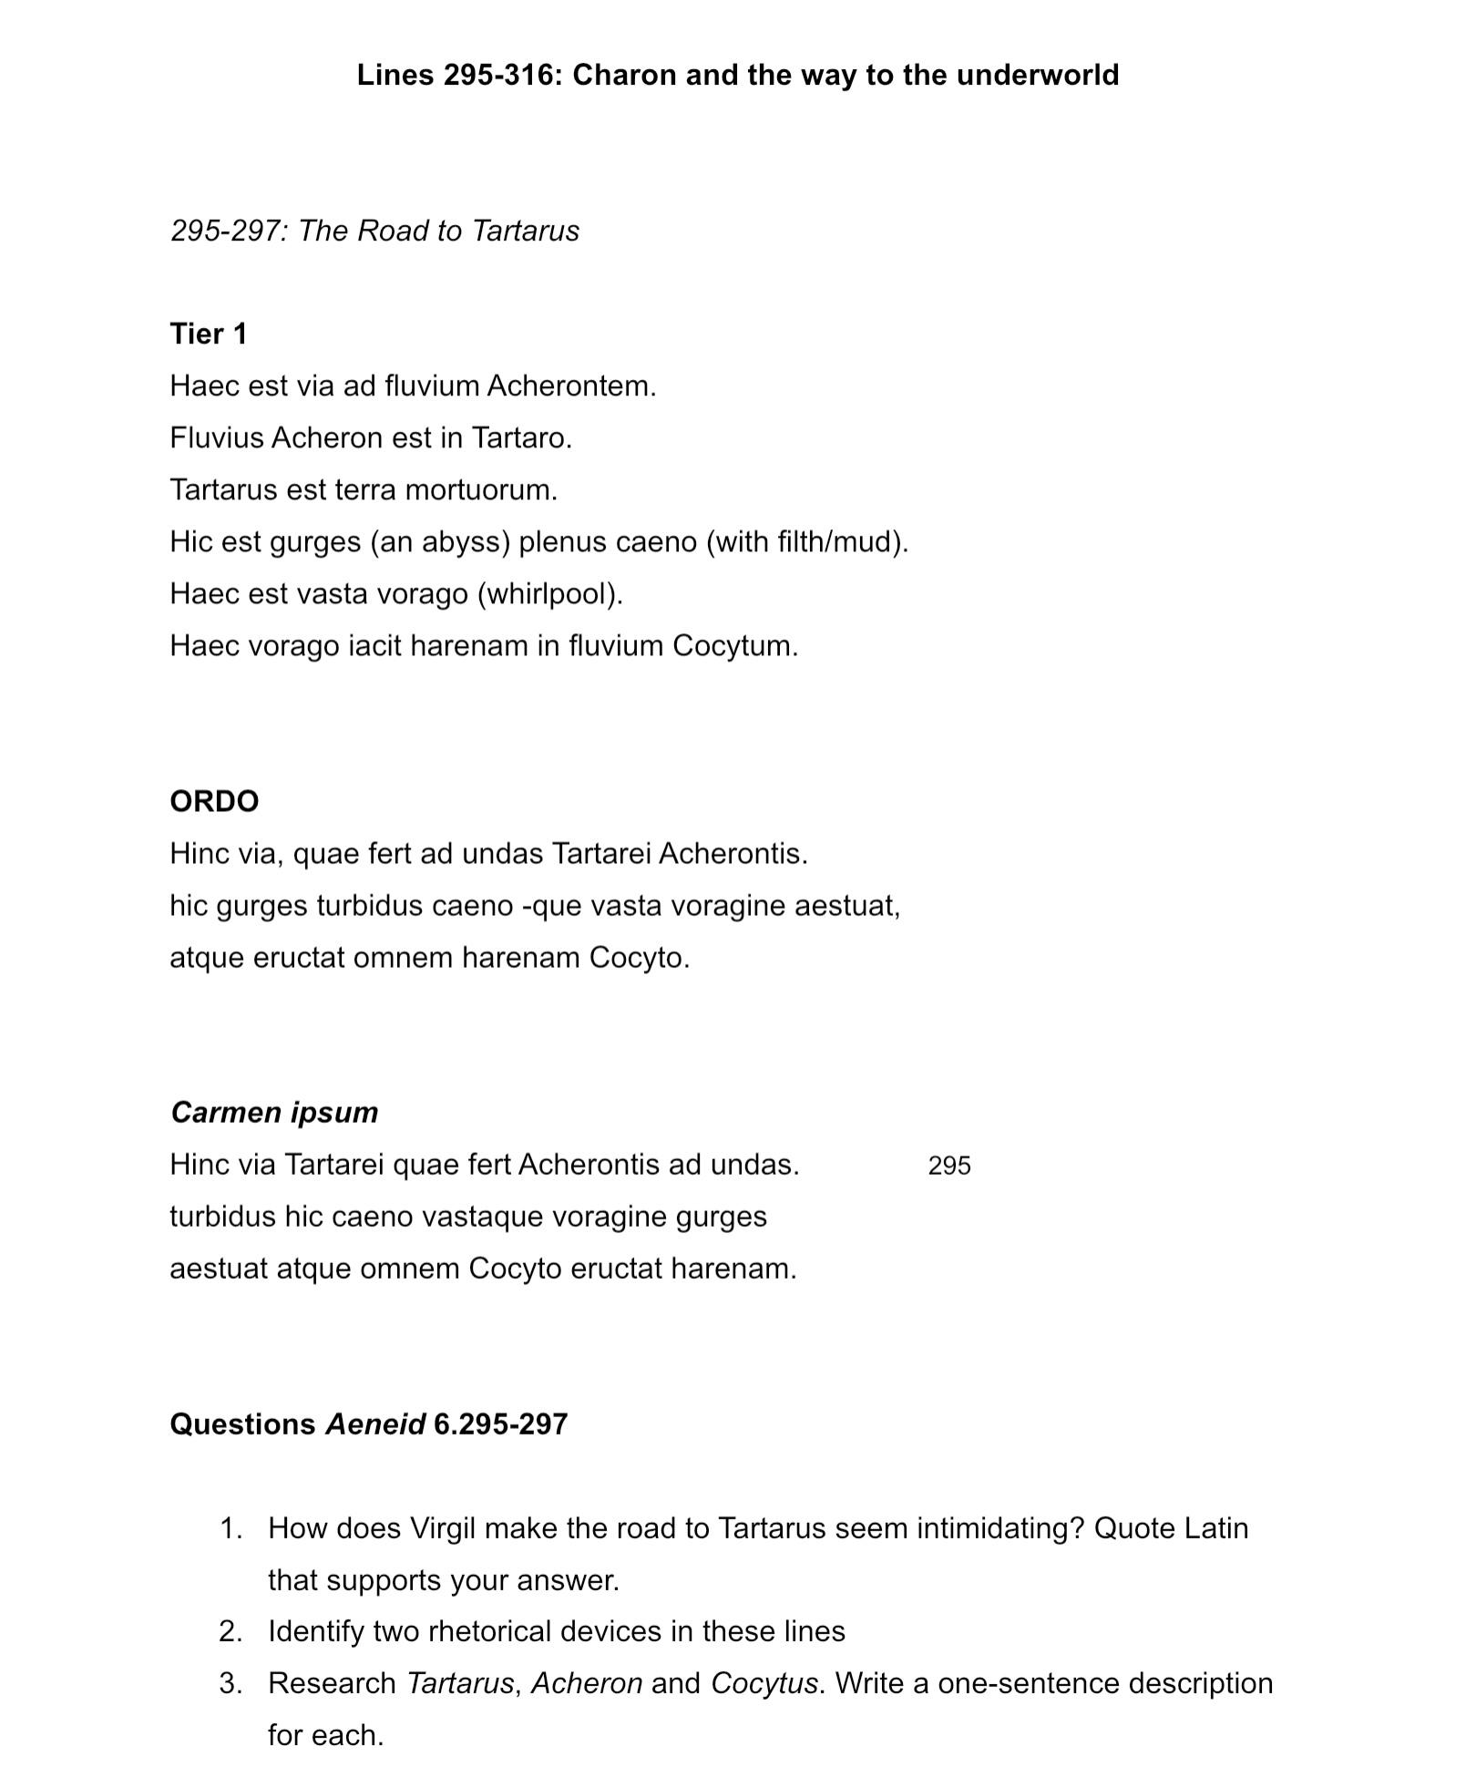
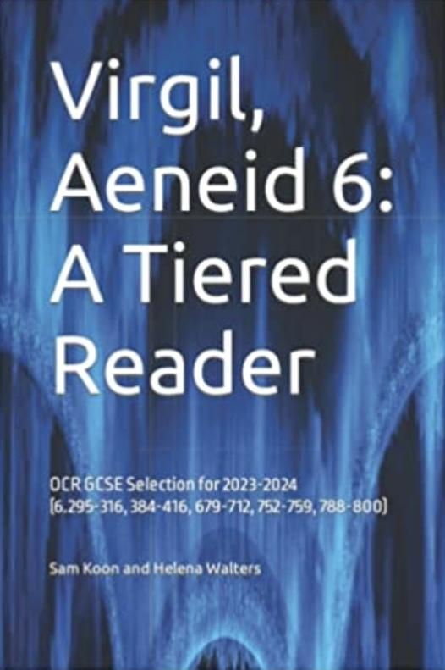
Koon and Walters (2022)

Slide 13
What are examiners looking for in set texts?
Content
Word choice
Word position

Slide 14
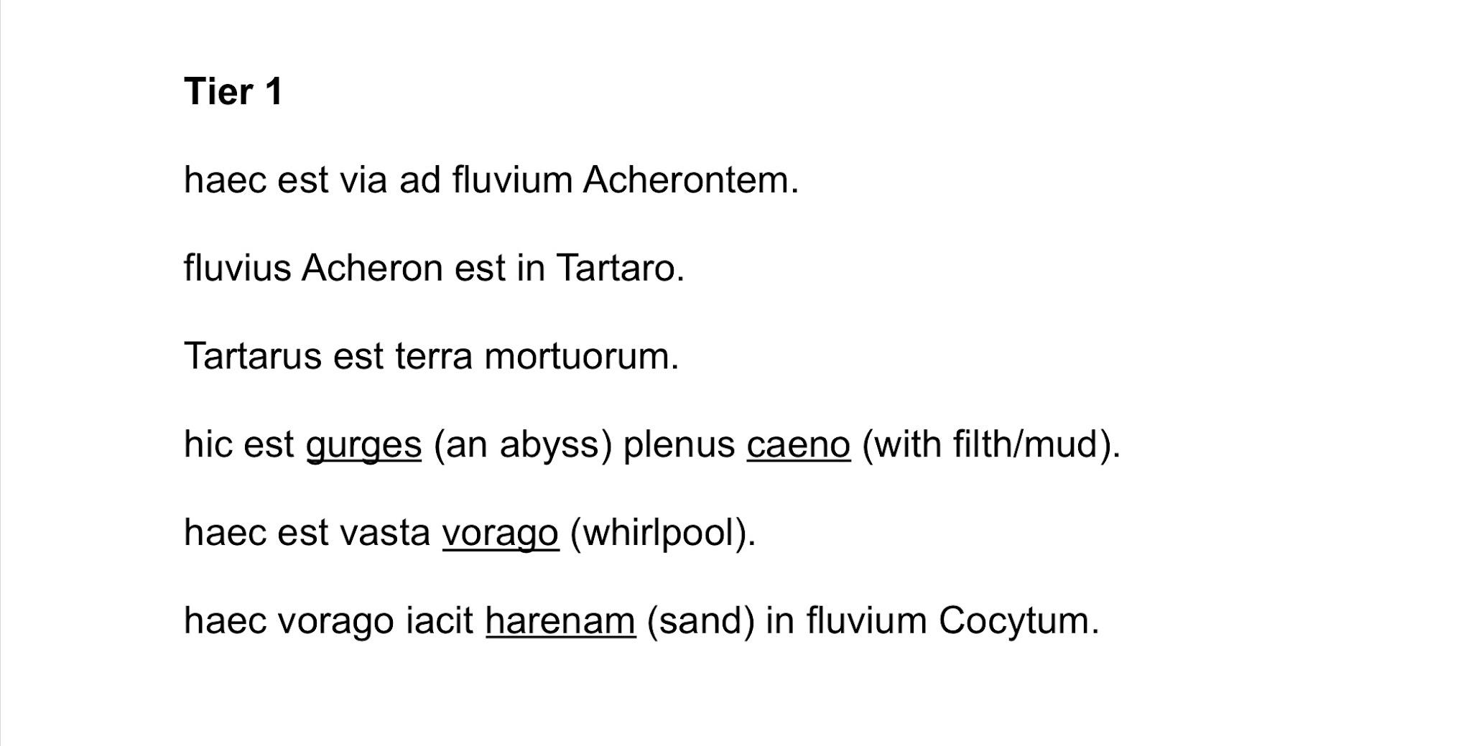
Tier 1: Content

Slide 15
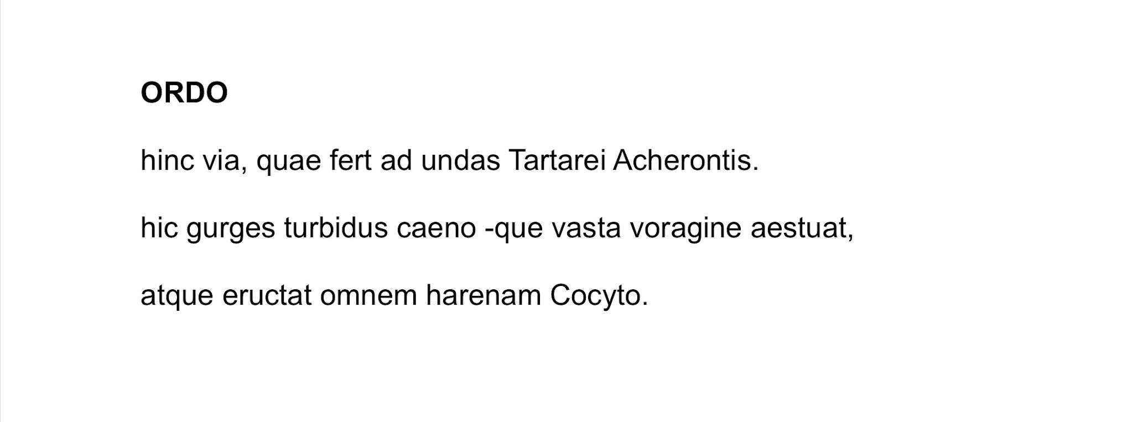
Tier 2: ORDO focuses on Word Choice

Slide 16
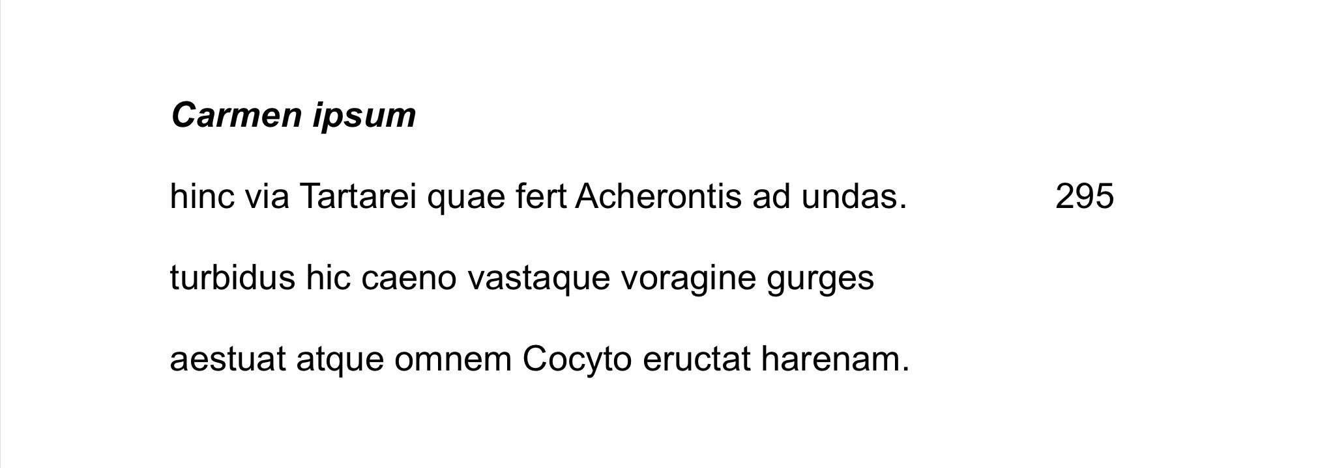
Tier 3: The original focuses on Word Position

Slide 17
Comprehension Questions

Slide 18
Benefits of Embedded Reading for Set Texts
The key benefit of embedded reading is the repetition of important material in an interesting and compelling way. This leads to mastery of the material.
Embedded Reading allows students the time and opportunity to understand fully a text or idea. I have found this approach better than others I have used in the past.
It helps pupils access authentic and challenging texts
Not limited to set texts, you can teach language through tiered readers too!

Slide 19
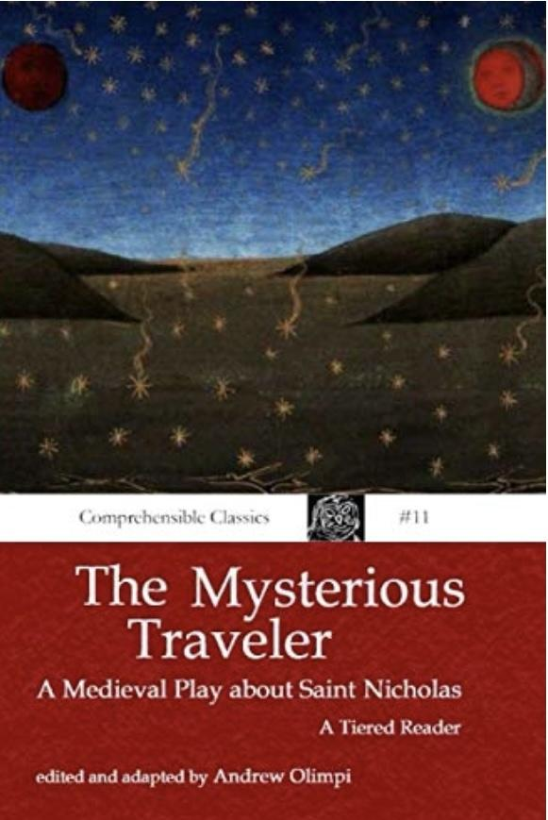
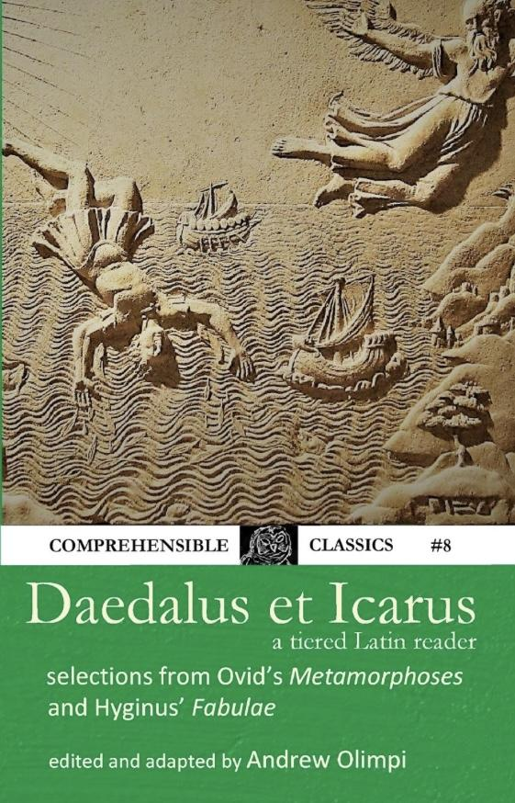
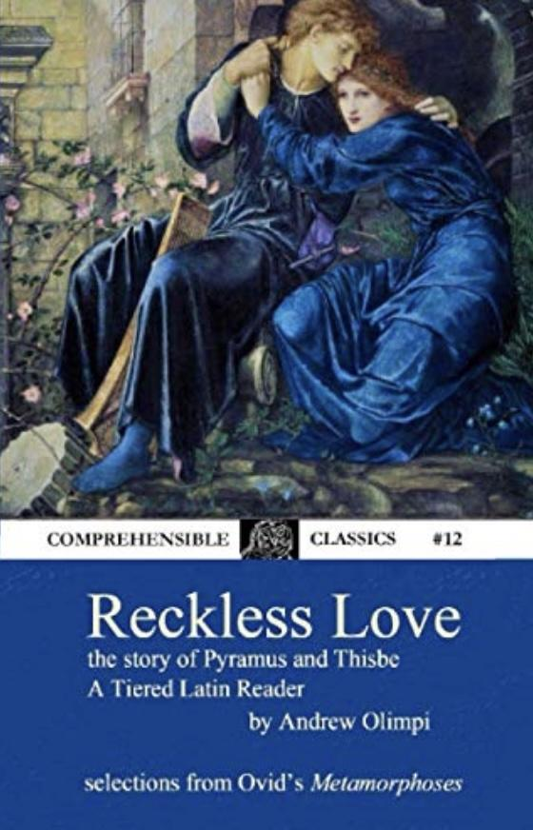
Available tiered readers: Andrew Olimpi

Slide 20
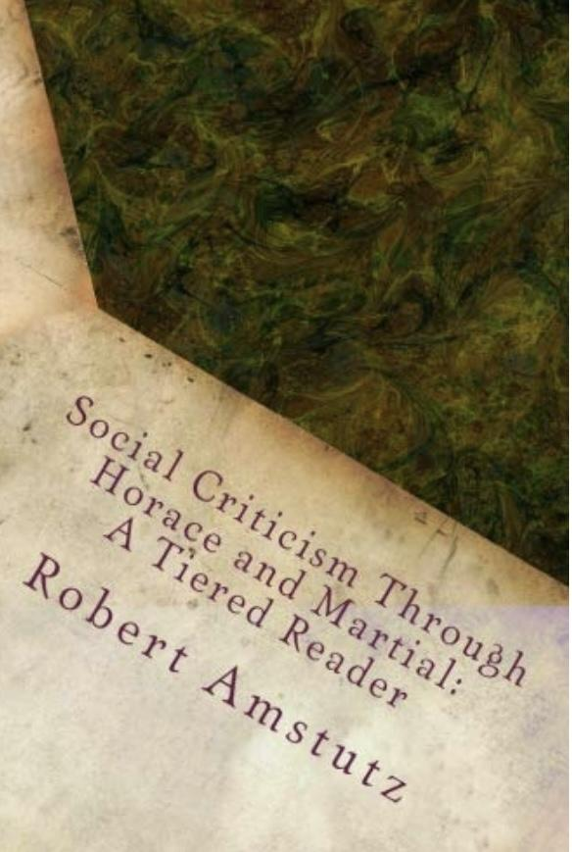
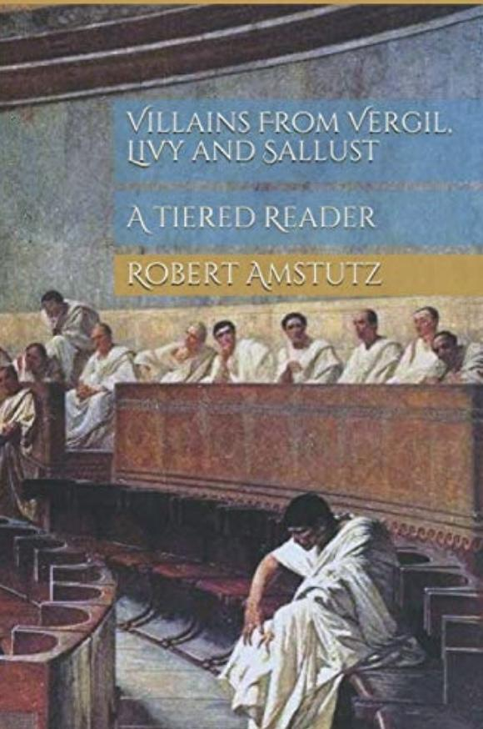
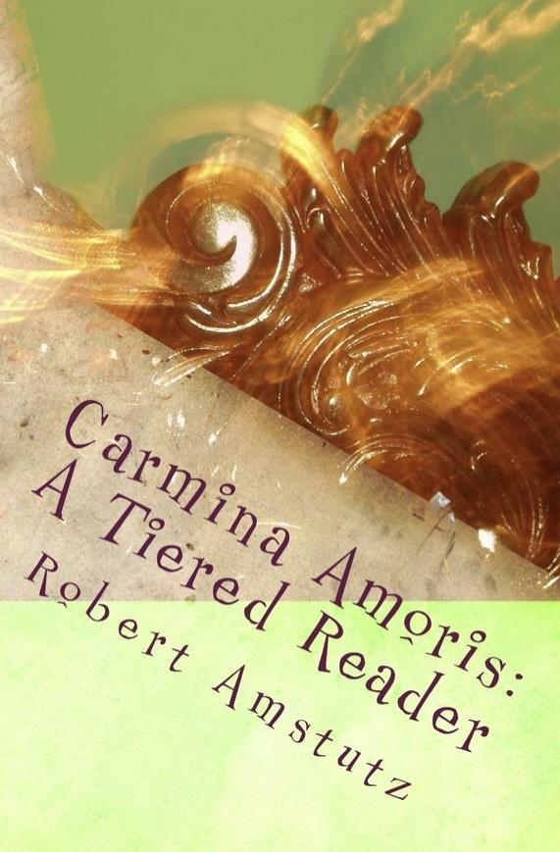
Available tiered readers: Robert Amstutz

