Slide 1
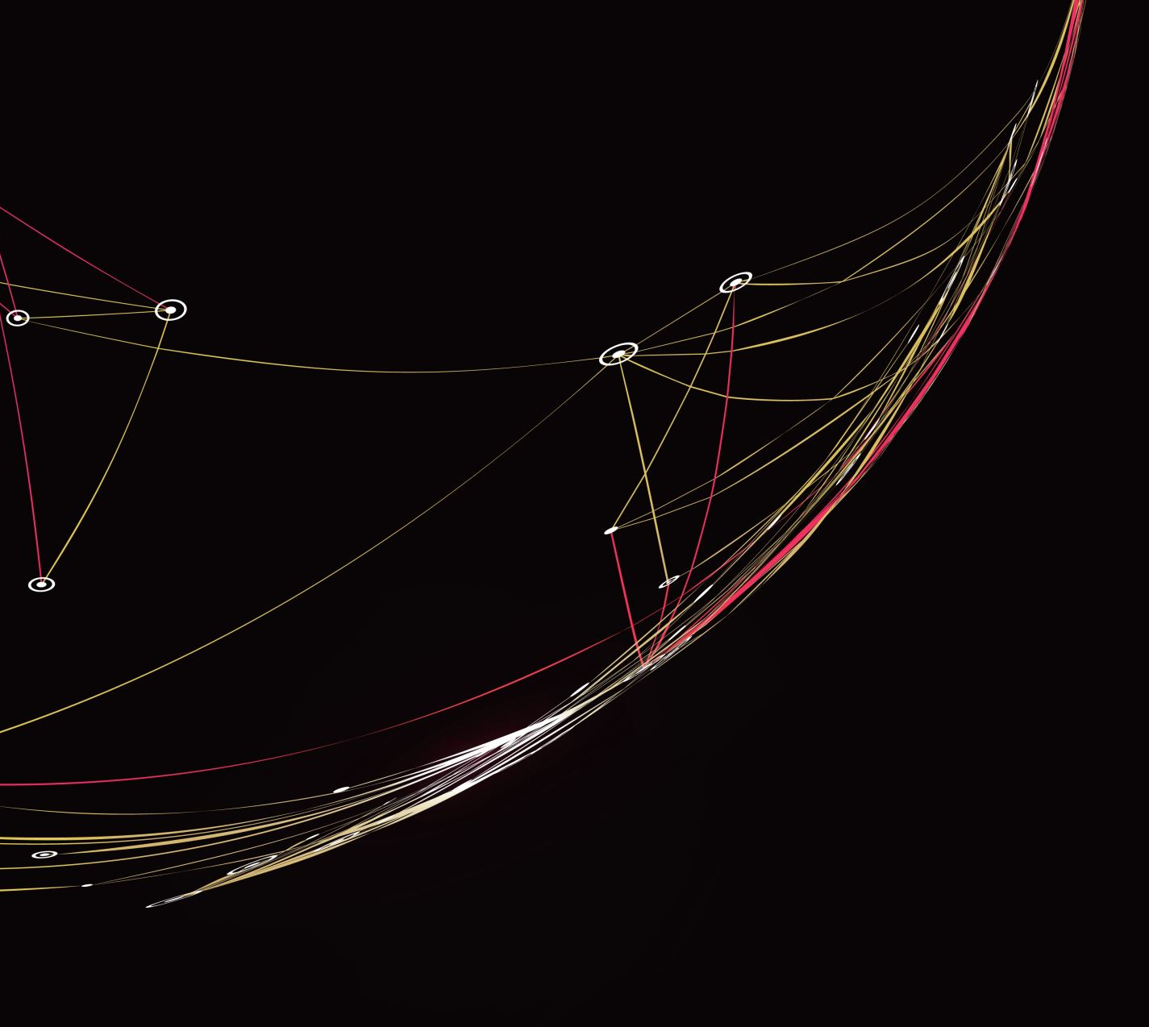
Enhancing Digital Literacy School of Humanities and Heritage
Background
Challenging the Curriculum
Understanding our Students
Mapping the Future
Michele Luigi Vescovi

Slide 2
1. Background: ‘Teaching and Learning in the Post-Pandemic World’ (2021-22)
identified issues related to the interactions between students and the digital environment (i.e., Blackboard, assessment instructions, etc)
Digital Literacy: (definition)
Students’ confidence using digital tools (including BB Sites and other digital platforms) and software packages (MS Word, etc.), as well as their ability to operate within digital environments and through computer-assisted processes, such as their skills in discovering information.

Slide 3
2. Challenging the Curriculum
Staff Survey on Digital Literacy (Dec. 2022) questions:
Students’ confidence in using digital tools and software at the beginning of their degree
University Induction
Which sort of digital skills would you like our students to have acquired by the end of Year 1?
Which sort of digital skills would you like our students to have acquired by the end of Year 3?
28 responses, recently discussed in a newly-established School Digital Literacy Working Group (more about this soon, #4)

Slide 4
-Survey results, organised- End of Year 1?
4. Mapping the Future
Mapping
Developing
Embedding
Research Skills
Digital Capability
library catalogue; locating suitable primary & secondary sources & reading them analytically. Some independence in using databases;
Finding skills using different databases/archival information (not archives themselves)
(Basic Keyword searches; locate academic information; filter and sort these results; assess reliability and quality, start understanding search algorithms)
How to deal with mass of incoming email to identify and keep up with what's important/relevant to them - strategies; using different techniques to prepare and to present assessed work
Software Skills
Confident using Blackboard, PowerPoint, Word, Talis, and a couple of software in the Adobe Suite (relevant to Conservation processes or individual degrees)

