Slide 1
Multi-modal workbooks for improving set text work
Dr Cressida Ryan
University of Oxford

Slide 2
Situation (“Problem”)
Students know what the text ‘says’ so why are they learning Greek?
The text is largely written by non-native speakers and so is not always ‘good Greek’
Each author’s style is very different
The vocabulary is huge, but has a relatively small core
The level is much harder than most beginners students would be expected to achieve in 60 contact hours
While ‘learning styles’ may be outdated, it is true that the same course aims and objectives can be reached in multiple ways, and students will benefit from different combinations of these.
Students don’t know what ‘prepare’ means for a set text.

Slide 3
Vocab list questions
Add in any points which might help you to remember these words.
Match these words to the places where you need them in the text, and work out what form of the word is used in context.
Read the passage and make a note of any words you don’t know. Check this list against the one below. If there are more words you need to look up, look them up now, but also make a note of them somewhere else as they are core words you definitely need to know.
Which of these words do you think are really important to learn, and which do you think might be very specific to this passage?

Slide 4
Vocab list spreadsheet

Slide 5
Comprehensible input / tiered readings
My version
εἰ μια γυνη ἐχει δεκα δραχμας και ἀποβαλλει μιαν, οὐχ ἁπτει λυχνον και καθαριζει την οἰκιαν και ζητει; εὑρισκει και συψκαλει τας φιλας και γειτονας. λεγει ‘Χαιρετε, διοτι εὑρον την μιαν δραχμην.’ λεγω ὑμιν, ἐσται χαρα ἐνωπιον των ἀγγελων του θεου περι ἑνος ὁς μετανοει.
Luke’s version
8 Ἢ τίς γυνὴ δραχμὰς ἔχουσα δέκα ἐὰν ἀπολέσῃ δραχμὴν μίαν, οὐχὶ ἅπτει λύχνον καὶ σαροῖ τὴν οἰκίαν καὶ ζητεῖ ἐπιμελῶς ἕως οὗ εὕρῃ; 9 καὶ εὑροῦσα συγκαλεῖ τὰς φίλας καὶ γείτονας λέγουσα, Συγχάρητέ μοι, ὅτι εὗρον τὴν δραχμὴν ἣν ἀπώλεσα. 10 οὕτως, λέγω ὑμῖν, γίνεται χαρὰ ἐνώπιον τῶν ἀγγέλων τοῦ θεοῦ ἐπὶ ἑνὶ ἁμαρτωλῷ μετανοοῦντι.

Slide 6
Other activities
Collaborative commentaries on translation comparisons
Translating the text into different styles and explaining the styles
Write commented translations, potentially contributing to an international crowd-sourcing project
Compare and contrast translations
Compare and contrast visual representations of the text
Write your own tiered version
Unscramble different translations
Respond to ChatGPT translations and discussions of translations
Diagram texts to look at rhetorical structure
Textual critical discussion
Lexical frequency and distribution discussion
Questions
What did you find difficult about this passage?
Where would you find backup support to explain?
What would you need to help you explain it to another beginner?

Slide 7
Support video resources 1
Reading out the text
Commenting on grammar and working through difficult clauses
Commenting on unusual words, including corpus statistics
Stylistic comments
Textual criticism discussion
Relevant linguistically-grounded exegetical comment

Slide 8
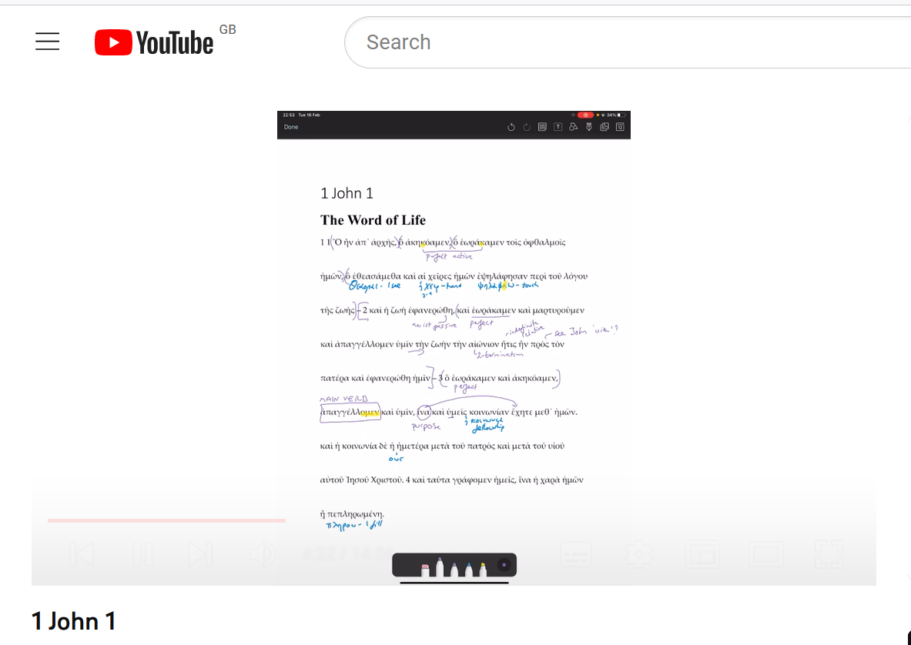
Support video resources 2

Slide 9
Other digital activities include…
Voice recordings of the text by section, to be listened to in isolation, or alongside the printed text.
Listening comprehension
Dictation tasks
Drag and drop paraphrases / summaries of the action into the correct order
Highlighting parts of speech to be learned Drag and drop Greek sentences into the correct order
Vocabulary “flashcards”
Kahoot comprehension quizzes and last-man standing quizzes to check for understanding

Slide 10
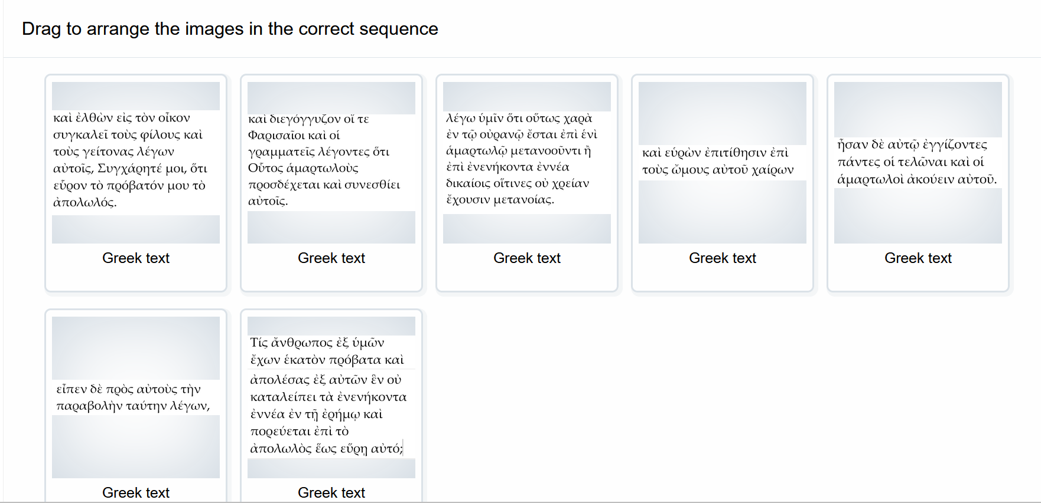
Some digital activities

Slide 11
Benefits of the approach
Leads to deeper understanding of the text
Students feel more personalised learning is happening
More collaborative working can happen
More in keeping with what we know about Second Language Acquisition
Makes revision easier for students as resources are all there
Allows for more interesting assessment tasks
Contact: cressida.ryan@gmail.com / cressida.ryan@theology.ox.ac.uk

