Slide 1



Past Pedagogies, Present Perspectives, and Future Directions: Reading Classics Online
Monday 15th May 2023, University of Lincoln

Slide 2
Past Pedagogies, Present Perspectives, and Future Directions: Reading Classics Online, Monday 15th May 2023, University of Lincoln
Introductions
11.10-12.20: Roundtable 1- Perspectives from Classical Studies at the University of Lincoln
12.20-1.00: Lunch
1.00-2.20: Roundtable 2- Perspectives from other disciplinary and institutional contexts
2.20-2.40: Break
2.40–3.50: Roundtable 3- Perspectives from secondary school contexts
3.50-4.00: Conclusions
Guiding questions
What are the challenges of engaging with digital texts in online platforms?
What are the potential benefits?
Which practices seem to be particularly effective?
What can we learn from one another (teachers, academics, students…)?

Slide 3






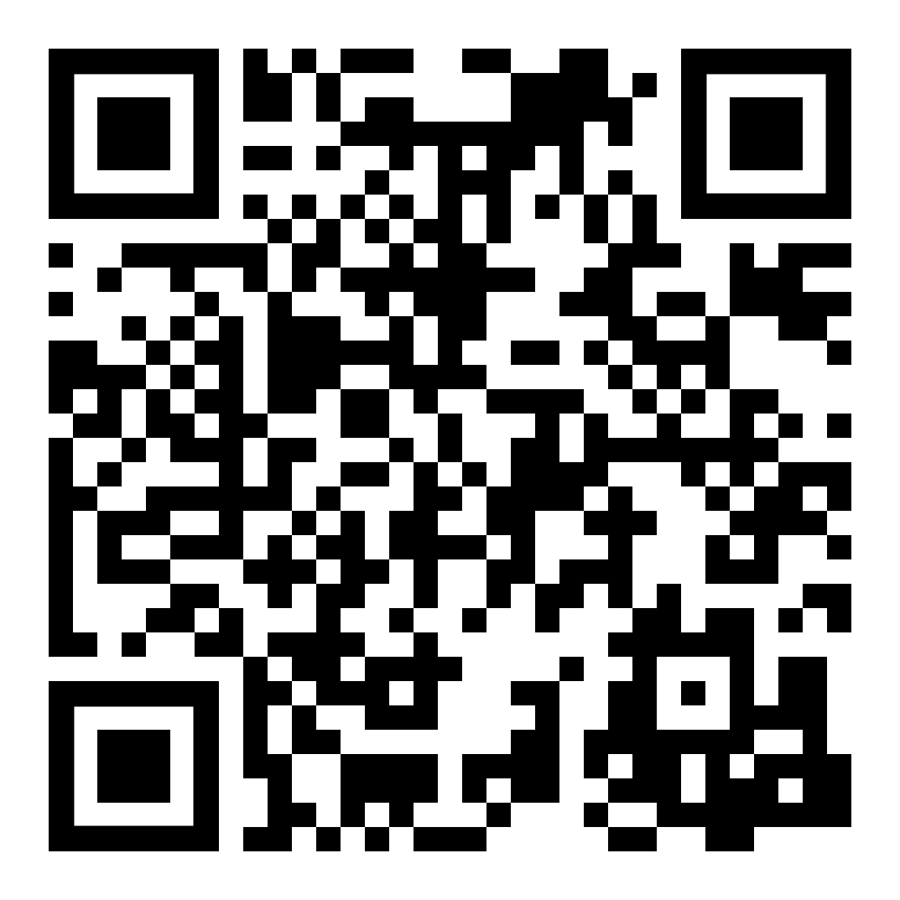
Active Online Reading
QAA-funded Collaborative Enhancement Project
April 2021-April 2022
Building on community of practice in History, but working with other disciplines and institutions
Students-as-partners (i.e. researchers)
https://makingdigitalhistory.co.uk/read/active-online-reading/

Slide 4
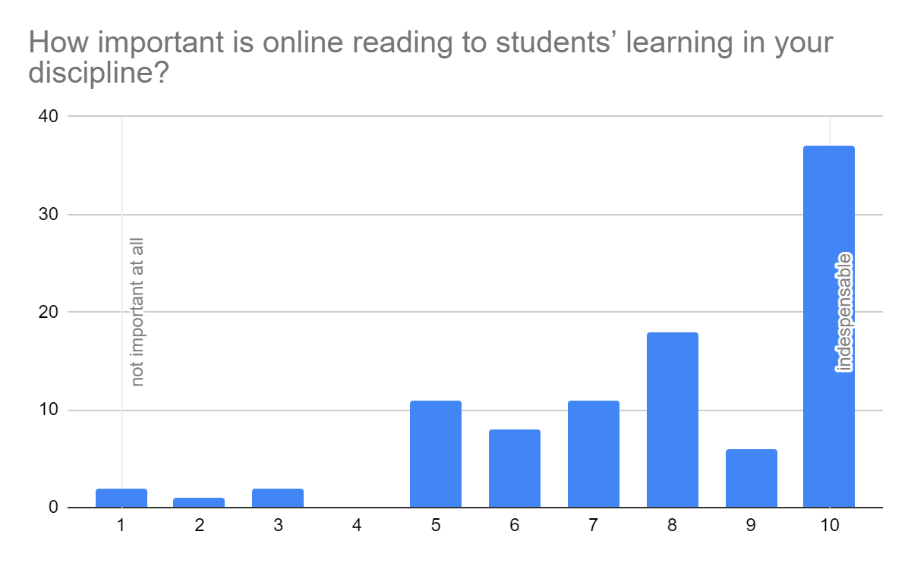
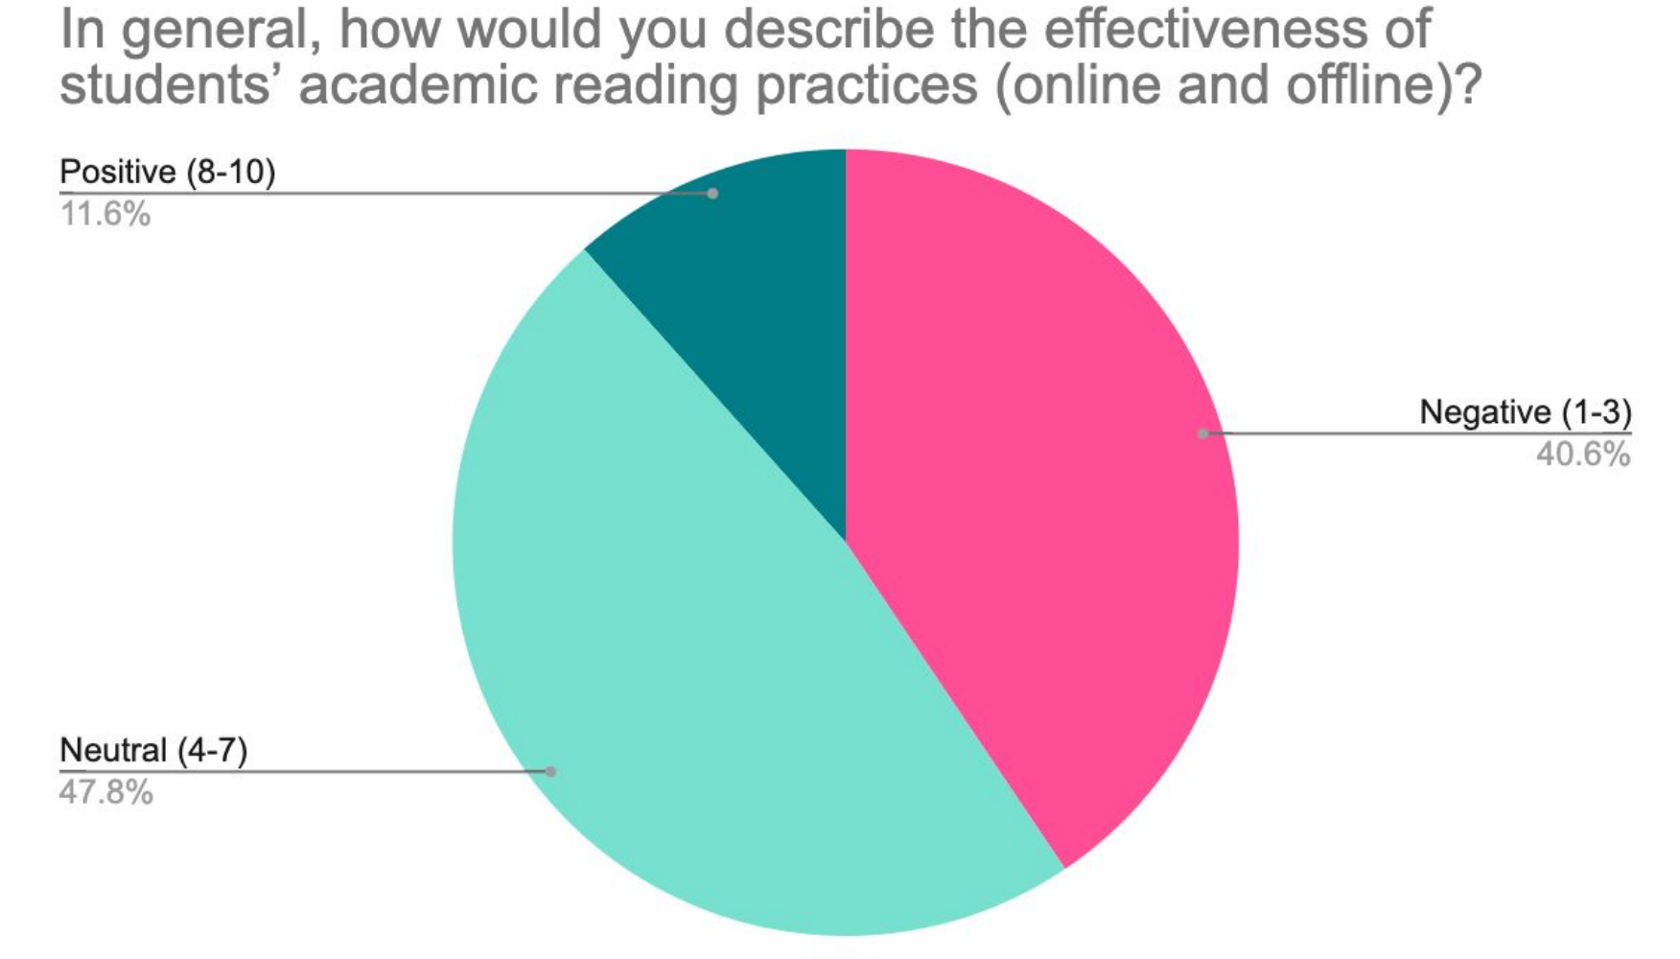
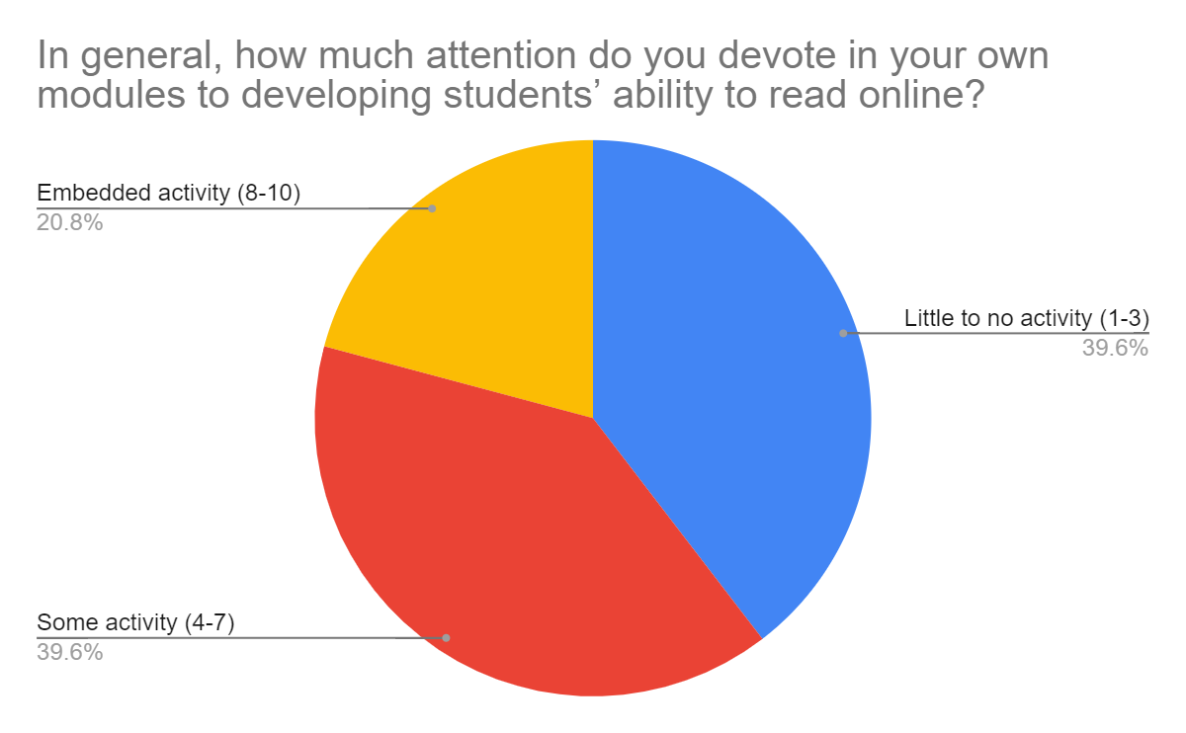

Slide 5
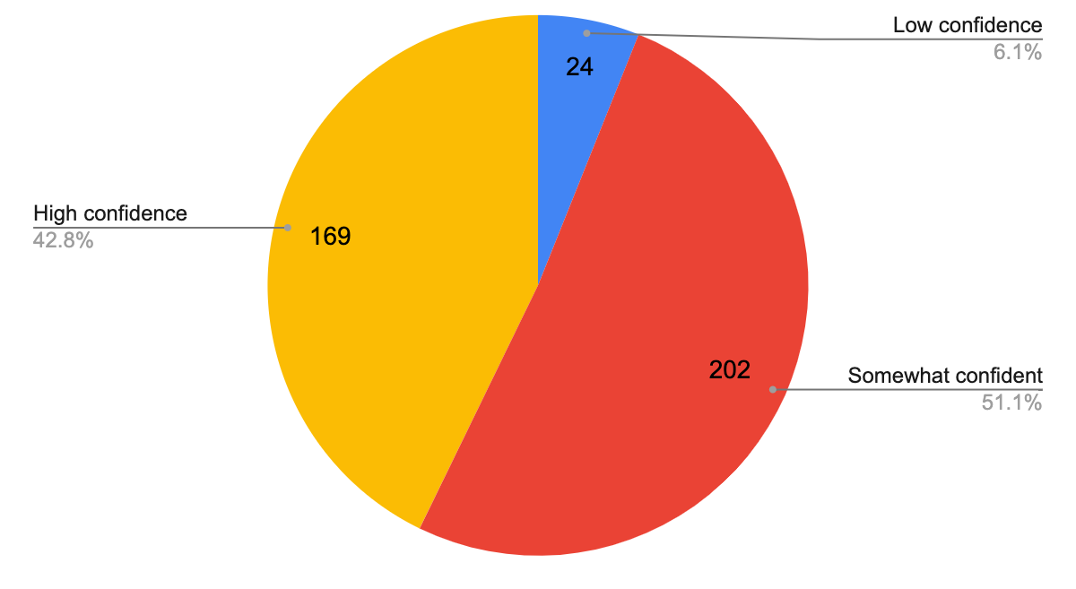
Student confidence in reading for studies (online and offline)
Staff ratings of students’ academic reading (online and offline)

Slide 6
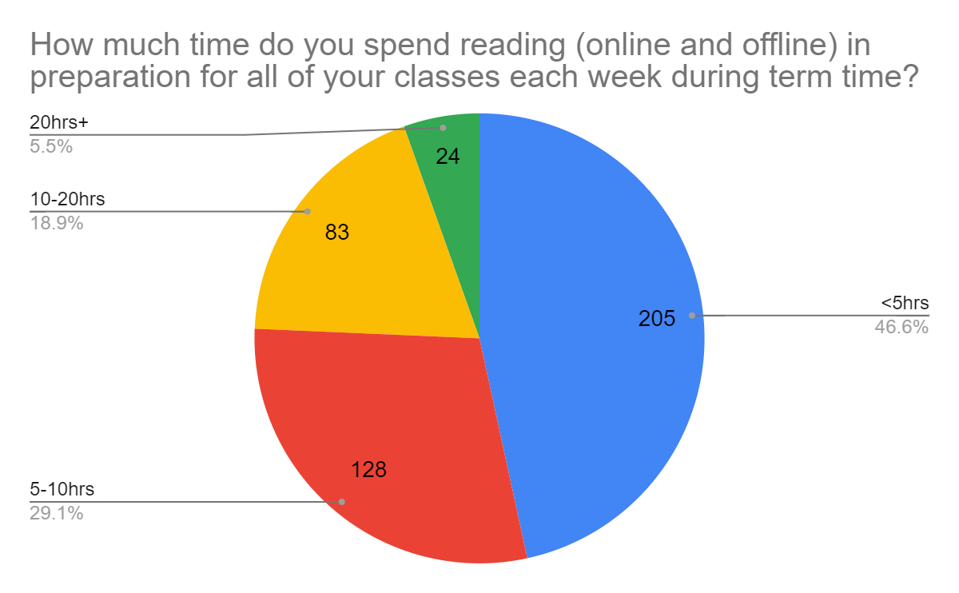
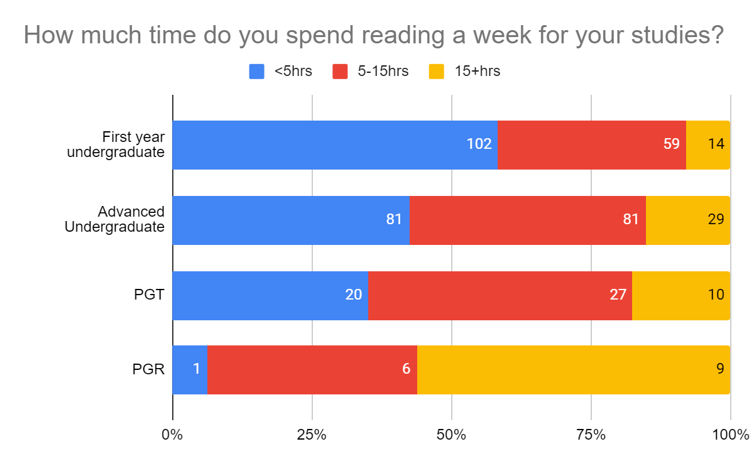
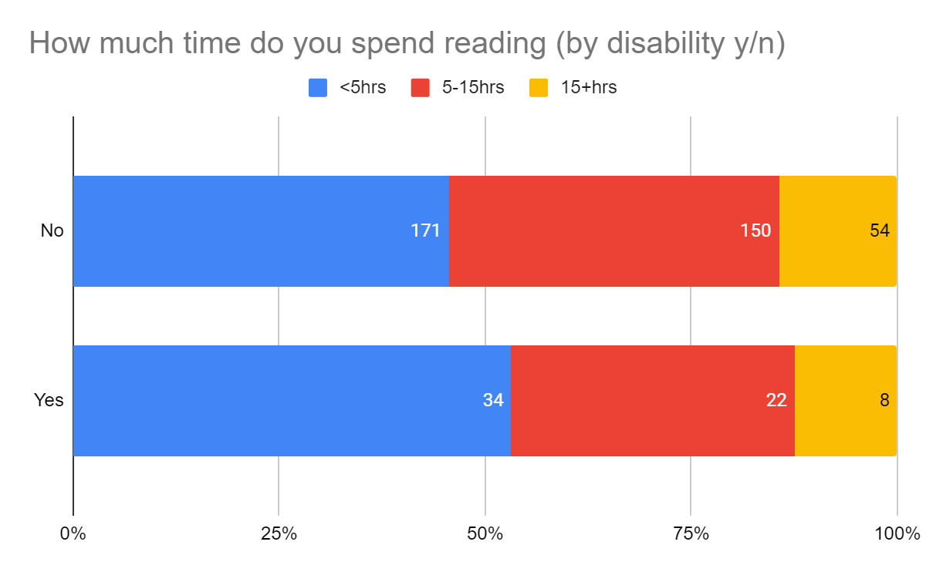

Slide 7
Some quotes
‘I skim read the vast majority of texts, unless it's an important text (for assessments etc.).’ (Classical Studies, UK)
‘I tend to print resources out if I can as reading online strains my eyes. But can't do this all the time.’ (English and History, UK)
‘I write hand-written notes whilst reading predominantly online material; although online works are easier to access, I tend to engage better with a physical book if I have a copy, which unfortunately is rare.’ (History, UK)
‘I find the reading too complex to understand’ (Fine Art, UK)

Slide 8
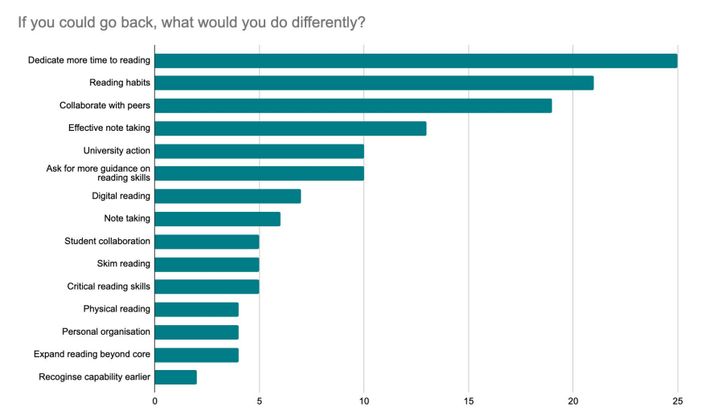
One thing I’d change

Slide 9
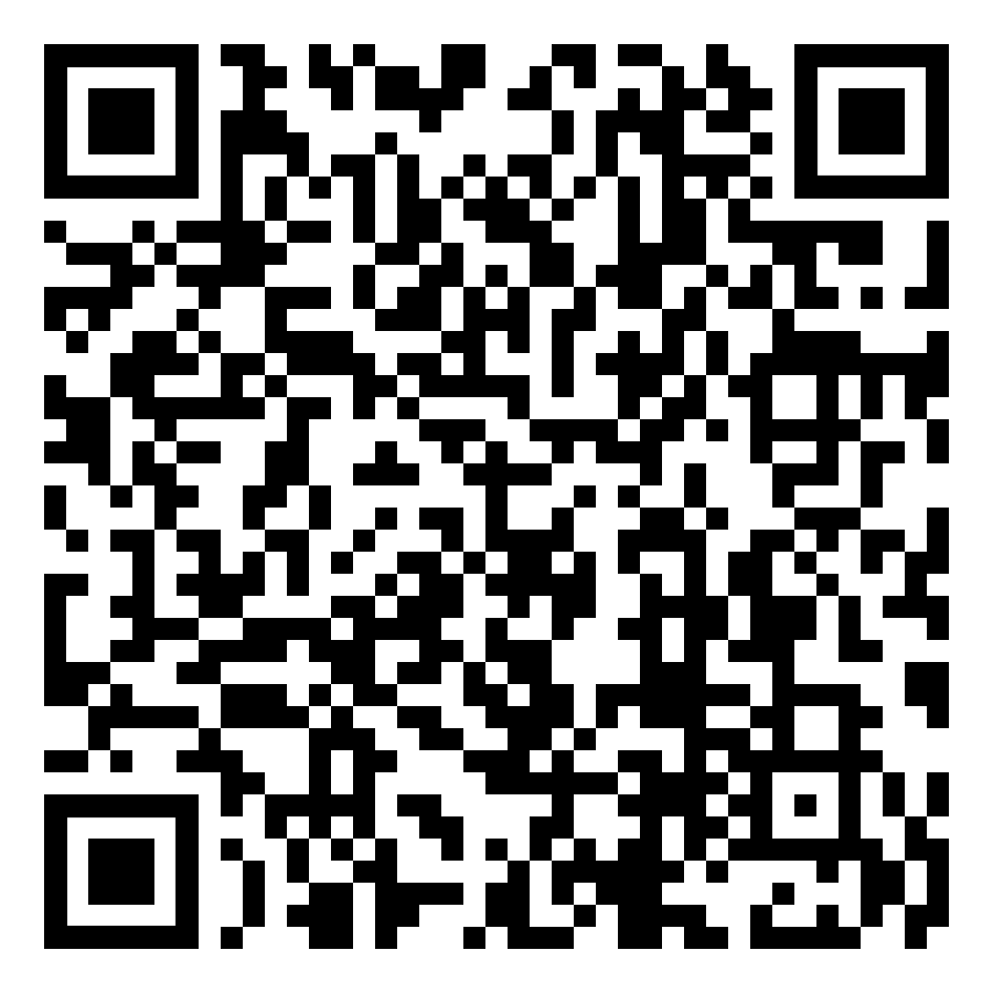
Infographics/ helpsheets

