Slide 1
Is the honeymoon over? Talis elevate, my students and me
Anna Rich-Abad,
History
University of Nottingham.

Slide 2
How have I done it?
Year 1 module (Making the Middle Ages
1 hour lecture –all cohort (200+ students)+ 1 hour seminar - small group (20 students)
Assessment, until this year, 2 historiography essays
Now 1 source based essay+ 1 synoptic essay
Talis asynchronous work and comments integrated in discussion in seminar
Each seminar group has its own Talis Elevate course –to keep private and sense of identity identity
Year 2 – The Stranger Next Door. Jews and Christians in the Middle Ages
(1 hour seminar+2 hours lecture a week).
Assessment: Primary Source essay based + Historiography based essay
Initially, Talis Elevate used asynchronously and discussed in seminar time alongside historiography.(Each group their own Talis page)
Notes:
During the pandemic:

Slide 3
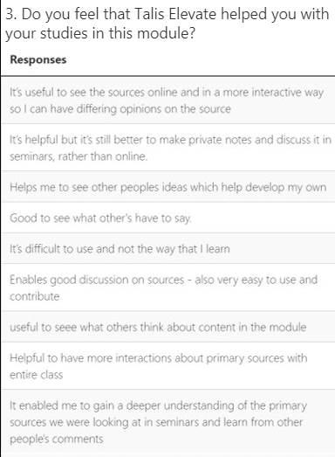
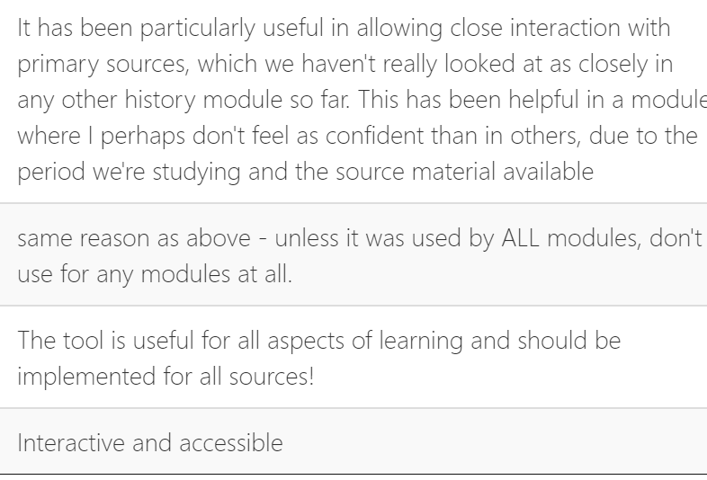
Student Feedback in 2020

Slide 4
Changes in practice: years 2021/22 and 22/23
Year 1.
Integrated as class work –synchronous –to complement lack of asynchronous lack of engagement.
Year 2.
Initially, used in 1 hour seminar alongside discussion of historiography
Now: embedded in lecture –

Slide 5
Why?
Y. 1
The covid effect over recruitment
Choppy transition from A levels to university (choppy A levels…)
Students tend to not engage with asynchronous class preparation
Lack of attendance and sociability in general
The mental health crisis?
Y. 2
Desired level of academic competence not really achieved. Lack of understanding of medieval texts among y.2 students – Lower attainment.
Class engagement/attendance issues
All levels:
Digital poverty
Screen fatigue
The native digital student? Learning platforms vs. Tik-Tok

Slide 6
What can be done?
Embed in assessment
Change assessment!
Incentivate and support staff to use digital technologies
Restore community

