Slide 1


Diversity and Inclusion in Digital Reading:
Reflections from the Active Online Reading Project
Dr Anna Rich-Abad, University of Nottingham
Prof. Jamie Wood, University of Lincoln
Project report: https://bit.ly/3ApbmWc
Project website: https://bit.ly/3XqMLun
Notes:
JAMIE

Slide 2
Overview
Introduction to the Active Online Reading Project
Advantages and challenges to Online Reading –Students and Staff Perspectives
Reflection and recommendations
Discussion
Notes:
Jamie

Slide 3







Active Online Reading project
QAA-funded Collaborative Enhancement Project
April 2021-April 2022
Community of practice in History
Broadening to other disciplines
Students-as-partners
Notes:
Anna
Rationale: Students’ reading practices have transformed over the past 20 years, with the increasing digitisation of resources, the emergence and then ubiquity of virtual learning environments, and the widespread use of mobile devices. The pandemic has accelerated such developments, with the rapid roll-out of online and blended learning. Yet we know strikingly little about how students read online, how this relates to their overall learning, and which pedagogic strategies are effective.
The research project started with a focus on the ‘reading-rich’ discipline of History, with a team based in three core institutions (Lincoln, Nottingham, UCL).
So., what is Active Online Reading? We define Active Online reading: as the practice of deep engagement with a text using techniques of annotating, responding, questioning, summarising, and sharing. An example would be reading an academic article and making notes on it with a fellow student in a shared document.
Three key elements underpin our approach:
A community of practice the project departed from the shared experiences, concerns and interest in online reading applied to History.
Broadening to other disciplines: we draw on insights from disciplines including Design and Business Studies, whose students are sometimes described as ‘reluctant readers’, and Classics, a cognate subject. Schoolteachers and teacher-educators will provide insights from pedagogic contexts with a stronger focus on reading development. We call this our community of practice.
Student engagement. Students will act as changemakers at all stages of the project. Student researchers will be employed at each core and partner institution.
In summary, the objective of the research was share best practices and to generate a suite of resources to support academics and students across all subjects.

Slide 4

Method
Workshops
Reflective blogs
Literature reviews
Case studies
Pedagogic resources
Surveys of staff and students
Notes:
Anna
We found out that the topic of reading and online reading was popular and there were many conversations around it. We wanted to gather these views and organise the information they provided.
We did this in several forms: (slide)

Slide 5

Survey
10 countries
50+ institutions
Humanities-heavy sample
Staff survey: 98 responses
Student survey: 442 responses
15% self-identified as having a disability that affects their ability to read
  Q: Have you been diagnosed with or do you consider yourself to have a disability that affects your ability to read (online and/or offline) for your studies?
Notes:
Jamie
Surveys in particular allowed us to gather data that we could process statistically
Importantly, it highlighted some insights on differences and particular issues experienced by students with disabilities.
Jamie-I have inverted the order of the list of items in the slide to emphazise the accessibility issues at the end

Slide 6
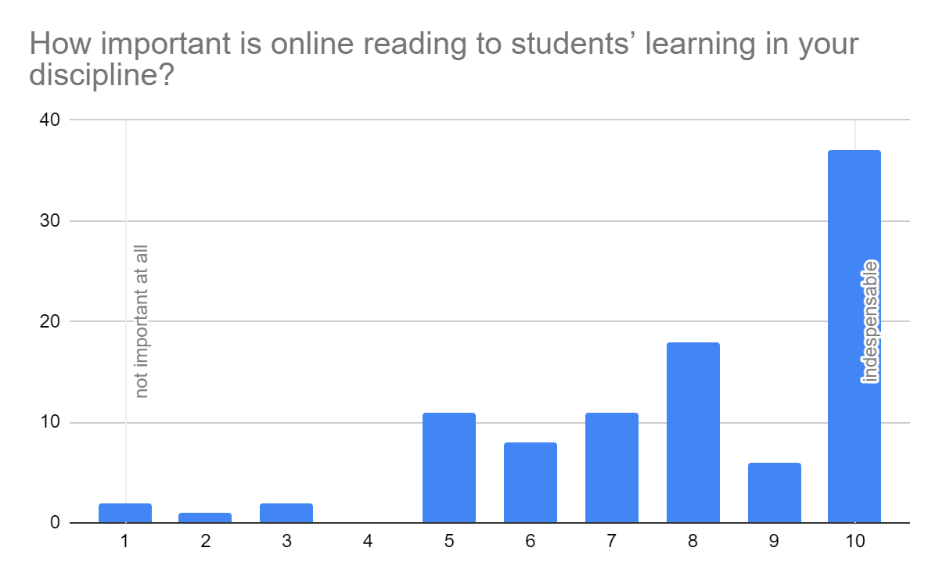
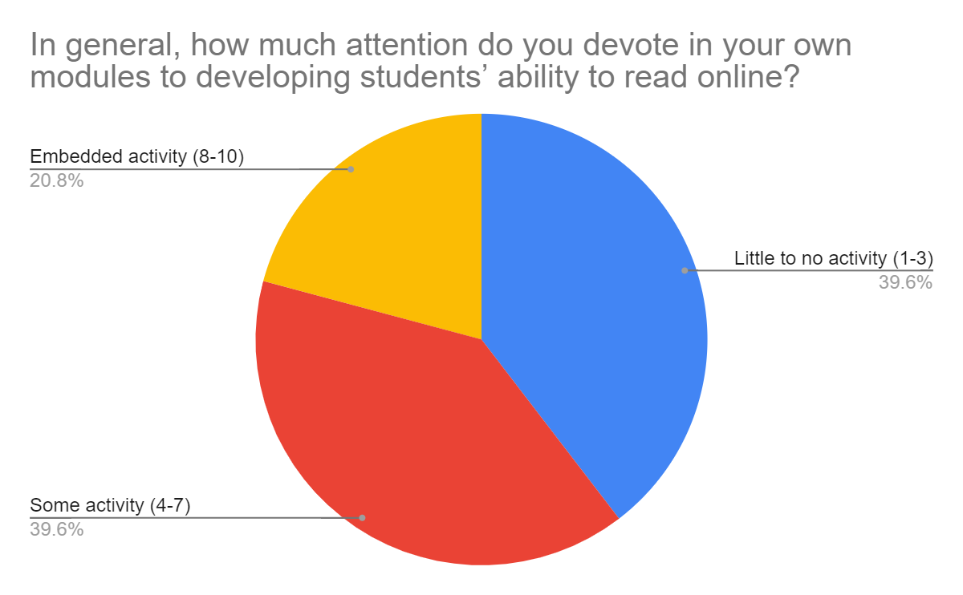
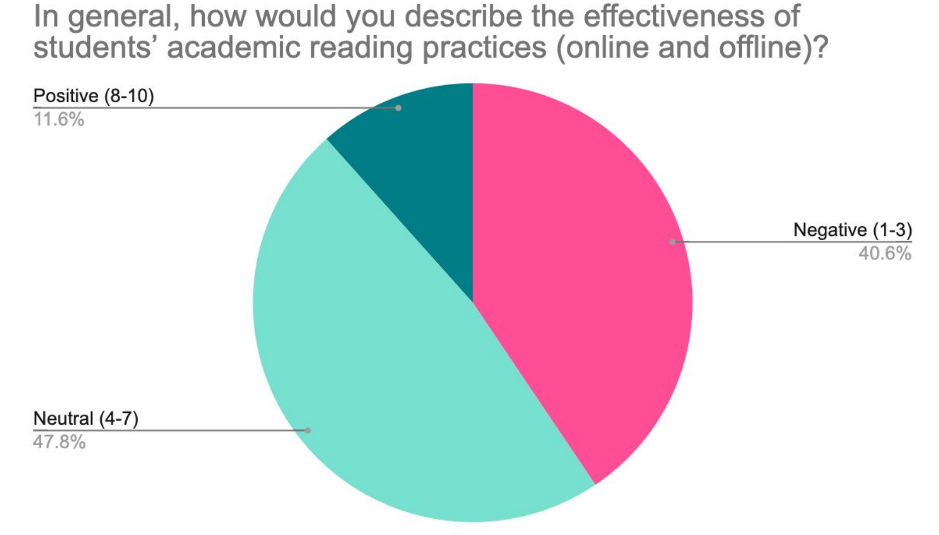
Staff questionnaire results
Notes:
Jamie Staff questionnaire results: (included title in slide)
Views on effectiveness of student reading practice contrasts with student views (next slide)

Slide 7
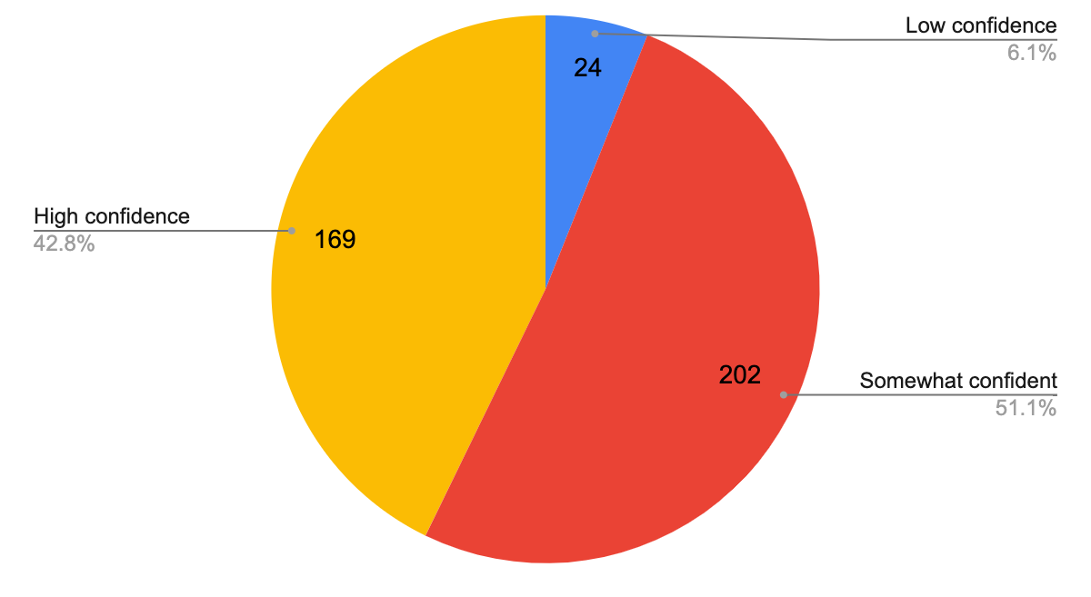
Staff/students’ perceptions
Student confidence in reading for studies (online and offline)
Staff ratings of students’ academic reading (online and offline)
Notes:
Jamie
Contrasting views between staff and students on active reading
So this was quite revealing and obviously raises questions on what is actually reading?

Slide 8
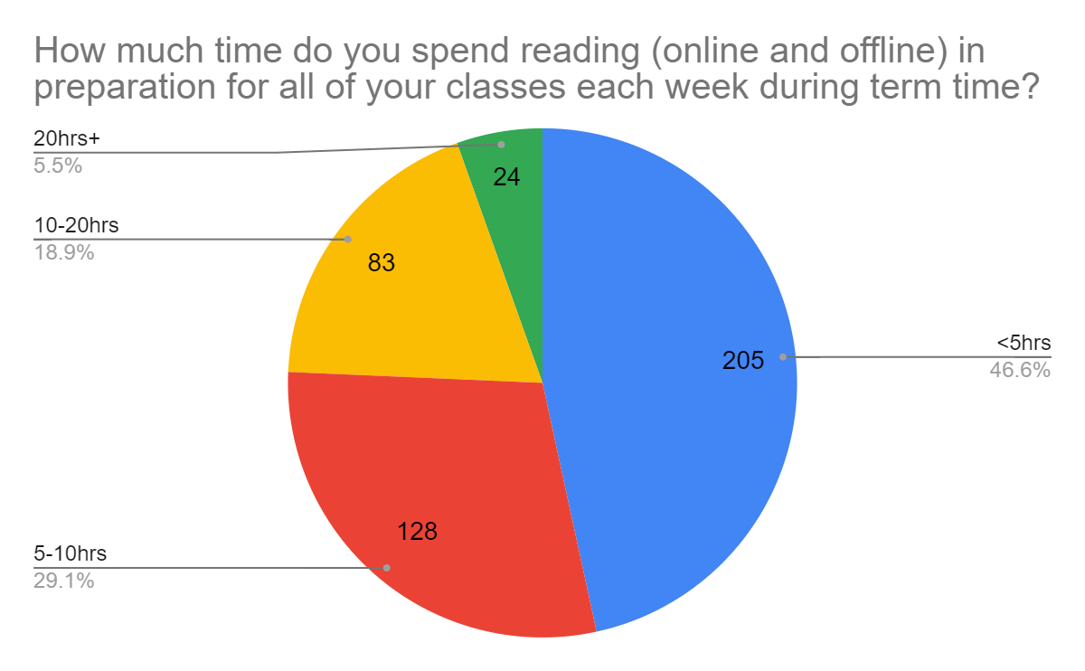
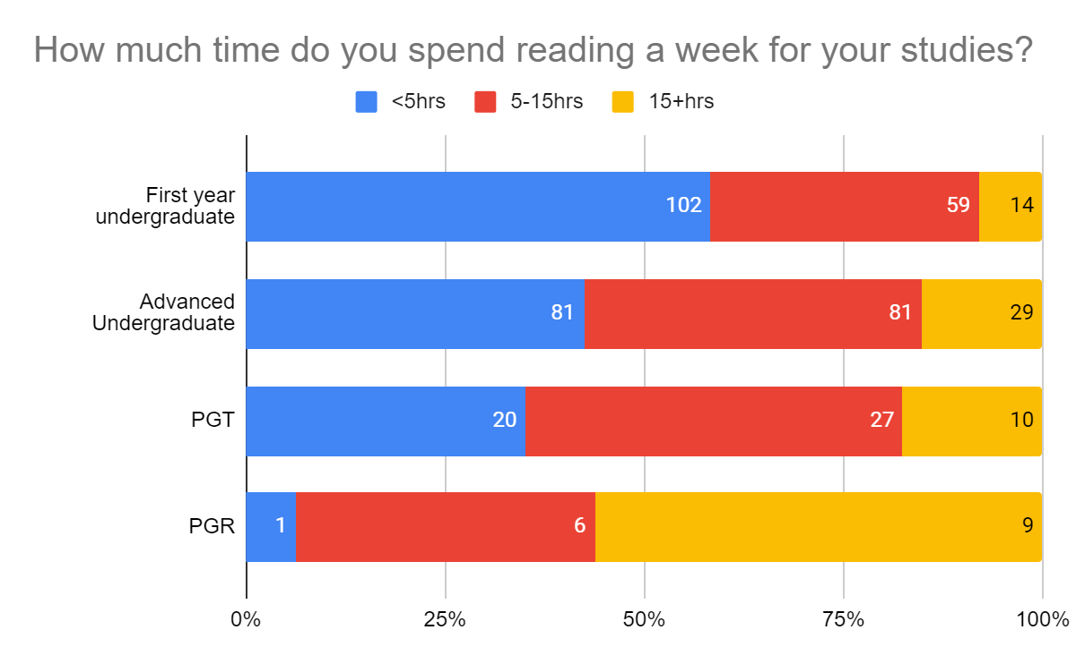
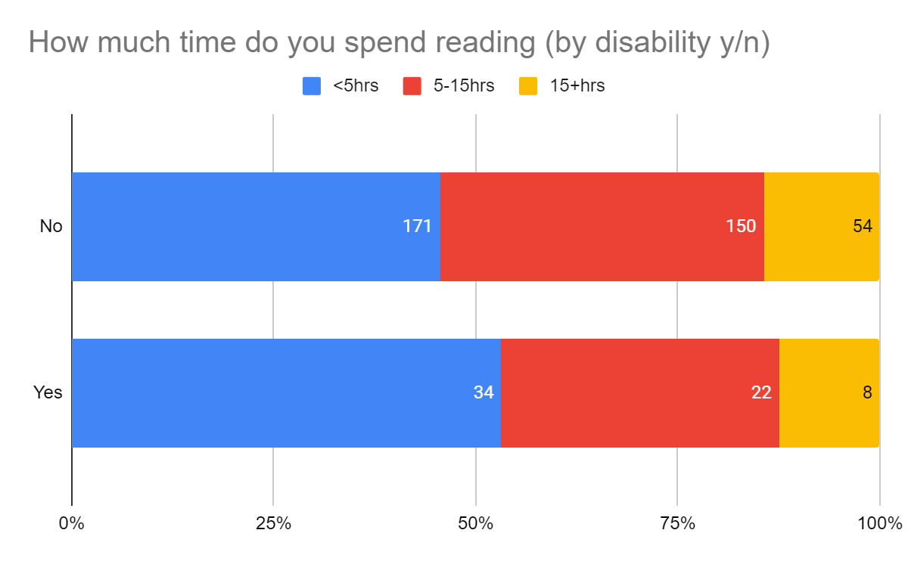
Students’ reading practice
Notes:
Jamie

Slide 9

Challenges
ACADEMIC Q: What sorts of challenges do students face when reading online for their academic studies?
“Students often struggle with academic reading in particular, unfamiliar vocabulary or theories can be a big barrier for less confident students, who do not have the skill or confidence to get the gist of a work (or read around unfamiliar material) and then go back and tackle questions or issues with the reading.”
Librarian, UK
STUDENT Q: What are the challenges of reading online for your studies?
Notes:
Anna
sample of quality information obtained from the questionnaires:
this
start with the one in the slide and introduce the question –leave deeper coment for slide 11 but not go over all of them
Introduce the question in slide 10

Slide 10
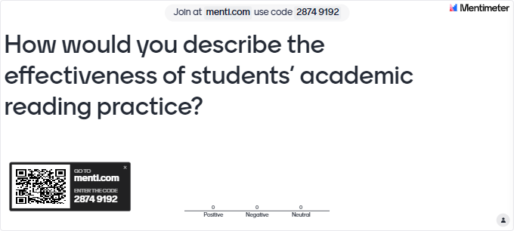
Question:
Notes:
Anna
can keep this depending on how interactive the session is?
How about we ask them the questions that we posed to staff and students (see previous slide)
Yep, slide and mentimeter updated

Slide 11
Challenges for students according to staff
“The usual obstacles include dyslexia, dyspraxia, ADHD, ADD, anxiety, depression, OCDs etc. We are, I think, getting good at supporting these barriers. The less obvious ones tend to include apathy, overwhelm, not finding the resources, confusion, or lack of self confidence, leading them to abandon the reading at the first point of resistance”
“… Concentrating with a screen. Accessibility issues especially for students with dyslexia in particular screen readers or the ability to personalise the experience. Note taking strategies. Critical thinking notes around what they have got from the text. How to get the most from the etext …”
“Lack of adequate equipment - mobile phones to read documents. […] Lack of support is a big one-- lecturers assume that students know how to read, and forget to teach them how to tackle an unfamiliar text. Online texts can be long or not very accessible; lecturers do not talk about ways to make the text accessible--it is assumed that students will know this. Normalising the use of assistive technology and of reading techniques friendly to neurodiversity, would not require academics to make radical changes but they act like their students are lazy or stupid for not figuring things out on their own.”
“synchronously - sharing thoughts on the spot can be daunting; asynchronously - the jury is still out how damaging screens are for us; definitely attention spans have become shorter, distractions more apparent”
Notes:
Anna
Different types of advantages and barriers in terms of accessibility as seen by staff
Physical and personal
Concentration/ accessibility for students
Building up confidence or a daunting prospective? Quote: sharing thoughts on the spot can be daunting
Visual strain : Same students commented : “the jury is still out how damaging screens are for us; definitely attention spans have become shorter, distractions more apparent
… Lack of quality control- the web is a huge bewildering place and is home to good articles and dreadful, unprofessional, articles. This is difficult to navigate when a student has not yet got much experience
… The challenge is in the approach. Most students assume that anything worth reading online will be immediately discoverable with a Google search.
… our library expend a lot of money in this resources and students did not know how to take advantage of it. I sincerely think that this is an enormous mistake of our staff. Mainly we have an oldaging staff that is not interested in learning digital methodologies, consequently do not teach them to the students –but younger staff may not be interested either …. (pressures on workload and misunderstandings about role of tutor as teacher are relevant too …)

Slide 12
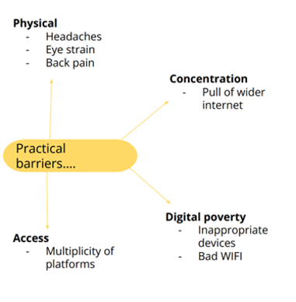
Challenges to online reading according to students
Occasionally, material isn't available online (for free) or it can be difficult to download. Not having a physical copy can be challenging in terms of note-making as this has to be done separately on a word document or paper. Not always practical as internet access is usually required and this is not always possible for example if a device breaks.
It can be hard to stay focused when reading for so long, not actually focussing on what you are reading. Writing feels less meaningful and satisfying when 3 pages of typed is like 6 handwritten pages. There is an increased degree of isolation with reading and studying online.
Eternal, agonising loneliness. It is so much harder to meet your coursemates and make friends when everyone is reading alone in there own little boxes reading off screens.
I don't engage with the material as much as I do with printed versions. I cannot read eBooks, for example, as staring at words on a screen hurts my eyes and the information doesn't sink in as well as a real book.
Not all texts are accessible, in respect to the technology I use for dyslexia.
ADHD makes it difficult. Feel like I would need support.
Notes:
Jamie
Student responses fall in different categories when referring to the barriers they find in engaging with active online reading:
Preferences:
Students may prefer physical copies so they can have a feel of the text and annotate (although some digital materials allow that)
Technical problems
When the text is only available as a scanned version, it can be harder for me to use, and I often end up having to print it out and make notes on the printed copy instead, often printing it on 4 pages per sheet to reduce the amount of space I have to focus on when reading (Student y. 1 Lincoln)
It doesn’t always sync in as easily as it does when reading it off of paper. (y.1. Nottingham)
On slide comment: Occasionally, material isn't available online (for free) or it can be difficult to download. Not having a physical copy can be challenging in terms of note-making as this has to be done separately on a word document or paper.
Digital poverty or limitation of access to devices:
“Not everyone has the economic means to have a tablet for example, where it’s easier to read online, because reading a text in a computer is much harder to focus. Also, not everyone has acess to internet in their homes, and can only read those texts in the few computers available in the university's library.”
Physical issues Eye strain
I don't engage with the material as much as I do with printed versions. I cannot read eBooks, for example, as staring at words on a screen hurts my eyes and the information doesn't sink in as well as a real book.
Disabilities: Students with dyslexia or ADHD find it difficult –though this is not developed.
i am heavily dyslexic, so reading is already difficult, but online makes it harder due to fonts, photocopies and what feels like endlessness because I have no physical input on how much I have left to read

Slide 13
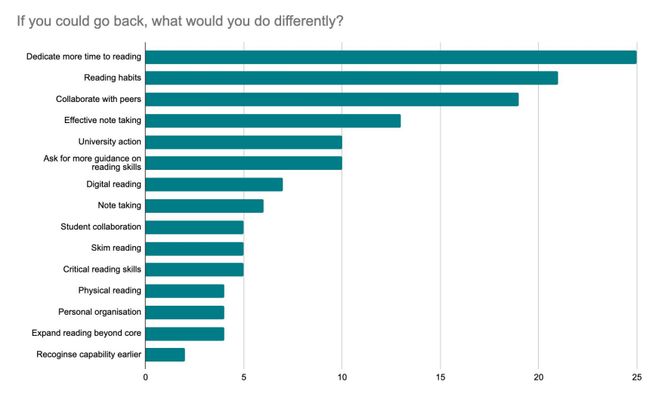
Students’ hindsight and recommendations
Recommendations
Embedding into course
  Core reading skills should be mandatory because skills needed in HE are different
  Note taking training
Collaborative reading
  Student-led/ timetabled reading groups
Digitisation of resources
Open access
Audiobooks/ read-aloud
Tips on avoiding distractions
One thing I’d change
Notes:
Jamie
Do we have something specific on accessibility and diversity????
Open access and audio books – it is all related

Slide 14

Help sheets
(download with the qr code))
Notes:
Jamie

Slide 15
Conclusions/reflections
Issues
Accessibility issues online and offline
  Cognitively –superficial vs deep reading. Cognitive mapping, scanning and pecking.
  Physically (health issues) yes, back, head
  Disabilities (dyslexia)
  Technically -problems with technology –sync, wi-fi issues
  Preference
  Digital poverty
  Digital natives?
  Sociability-loneliness
Lack of developed pedagogy for reading in HE (and limited to “skills”, not embedded on subject content)
Expectations vs. reality, for both staff and students
Transition: ‘readiness’ for academic reading in HE
Suggestions
Need to support students in developing healthy digital practices, including digital reading –social annotation, discussion or reading, provide guidelines for reading.
Embed digital reading into the modules –support from learning tech and collaboration
Support/provide alternatives to digital reading
Develop expertise. Share best practice.
Notes:
Anna
Focus on the issues, (the recommendations are for reference)
Ultimately, our research exposed a wide range of challenges faced by students and staff related to understanding of content with superficial instead of deep reading, and scanning and pecking of these contents (Sonoski, 1999 and Cohn, 2021). Online reading may lead also to health issues such as loss of memory and ability for cognitive mapping (Baron, 2021, p. 34).
Students also reported problems in socialisation, technological proficiency, and economic obstacles accessing appropriate technology (i.e., digital poverty). Students with learning difficulties found online reading particularly challenging, while staff and students spoken repeatedly about the physical challenges of online reading (e.g., eye ache, backache, headaches).
Conclusions:
Our broader investigation into approaches to supporting students to engage in reading digital text in online spaces, revealed that it is not at present a priority for academics, is often left to support departments such as the library, and, if it is addressed at all, is largely limited to induction and skills-development modules.
Given the prevalence of online/digital reading, these findings have very wide-ranging implications for all disciplines and for all students, especially those who face challenged relating to accessibility and inclusion.

Slide 16
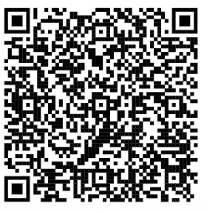

closing
Thank you!
Any questions?
Project report: https://bit.ly/3ApbmWc
Project website: https://bit.ly/3XqMLun

