Slide 1
Active Online Reading
Dr. Anna Rich-Abad, University of Nottingham
Prof. Jamie Wood, University of Lincoln
Anna Wray University of Nottingham
Notes:
JAMIE

Slide 2
Overview
Introduction to the project
Approach/methodology
Findings/results
What’s next?

Slide 3
Active Online Reading
Academic/student survey (mixed methods)
Reflective blogs from student researchers
Collaborative workshops
Longitudinal study; thematic/sentiment analysis of annotation activity
Literature review
Resources: case studies, infographics

Slide 4
Student researchers
Rachel: UCL
Catherine: University of Lincoln
Lee: Salford
Linh: Sheffield Hallam
Annabelle: University of Lincoln
Hannah: Sheffield Hallam
Samantha: University of Lincoln
Stefan: University of Nottingham
Anna: University of Nottingham

Slide 5
Surveys

Slide 6
Staff
Students
Perception of reading skill/capability
Strategies to encourage reading
Importance of reading
Perceived barriers to digital reading
Ownership of reading skills development/support
Platforms supporting/developing capability
AOB
Reading confidence
Reading habits
What support was available/where/how?
Time dedicated to reading
Challenges/blockers
Value of collaboration
What would you differently?

Slide 7
Student responses
Staff Responses
>100 Responses
38 institutions,with international responses
Academic/ Library/ Curriculum Development/ Researcher roles
75% Humanities
>650 respondents
56% UK Universities
15.8% respondents self-identified as having a disability that affected their ability to read

Slide 8
Findings

Slide 9
Question:
How would you describe the effectiveness of students’ academic reading practice?

Slide 10
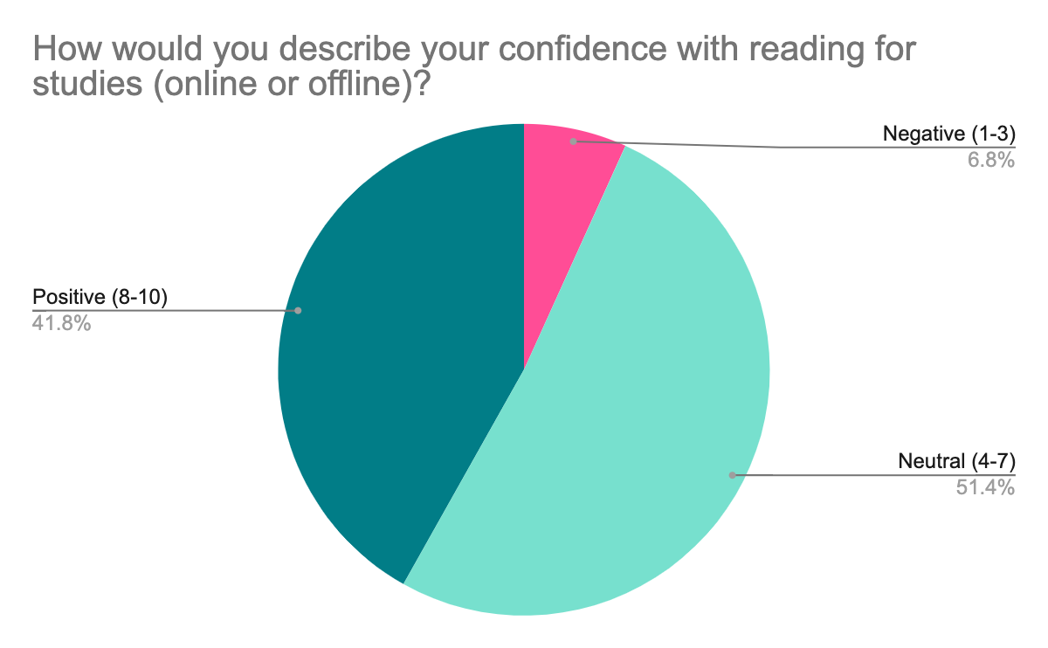
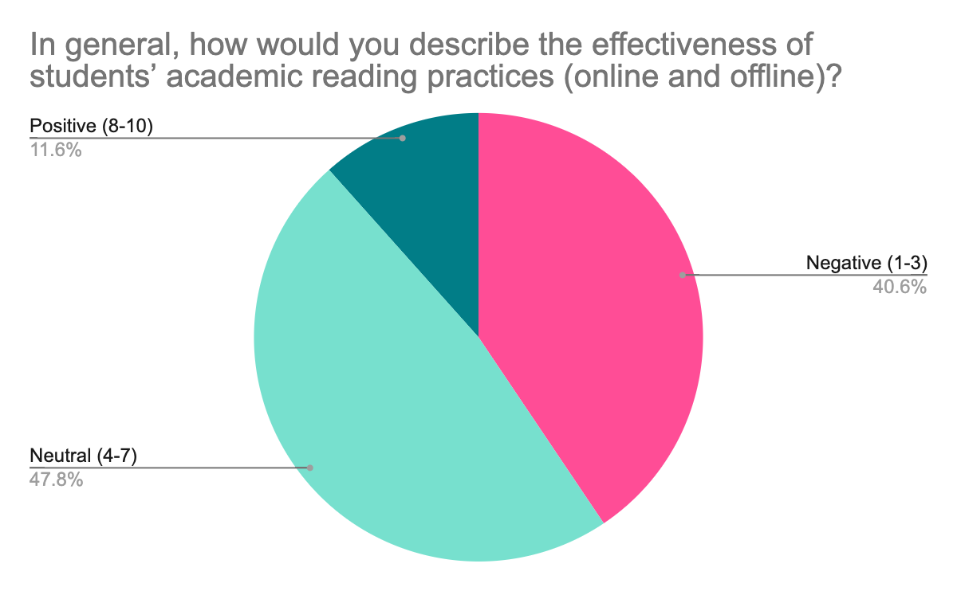
Student confidence
Staff perceptions

Slide 11
In general, how would you describe the effectiveness of students’ academic reading practices (online and offline)? [staff]
Not prioritised
Academic language a barrier
Mixed perception on improvement
Transition to HE seen as critical point: recognition of improvement over time
Prioritising certain practices (skim over deep)
Intrinsic motivation seen as key
Institutional support lacking
Social media perceived to impact approach to reading negatively
Gaps in key skills
“Once students know what they are supposed to read, for when, and have been given some grounding of the different reading skills required at University, I've generally found a good rate of engagement for most, with the usual candidates not engaging. The biggest problems I encounter are that there seems to be very little tenacity or resourcefulness…” (Associate Professor, Arts/Creative Industries, UK)
“Students often struggle with academic reading in particular, unfamiliar vocabulary or theories can be a big barrier for less confident students, who do not have the skill or confidence to get the gist of a work (or read around unfamiliar material) and then go back and tackle questions or issues with the reading.” (Librarian, UK)

Slide 12
Academics’ perceptions of barriers to student reading
Lack of core skills (information/digital/critical)
Distraction/Concentration
Lack of support/guidance
General reading challenges
Digital poverty/equitable access

Slide 13
Student perspectives on digital reading practice

Slide 14
Notes:
Anna W

Slide 15
Student reflections
I think I would be less obsessive with my reading practices - I've come to realise that it's ok not to write everything down, or get every piece of information. This change would definitely have made my reading experience far, far less stressful.”
Student: Sheffield Hallam
“I think it’s important to stay on top of reading. Definitely very important to be prepared. I think I would change my immersiveness with the reading. Maybe try and read more physical books instead of constantly online.”
Student: Monash University: Philosophy

Slide 16
Student suggestions to their universities
Embedding into course
Core reading skills should be mandatory. The skills needed in HE are different
Further note taking support
Digitisation of resources
Prioritise open access
Alternative formats (e.g. audiobooks, video)
Tips on avoiding distractions
Timetabled reading groups
Support student led reading groups

Slide 17
Key themes
Lack of developed pedagogy for reading in HE
Reading expectations vs. reading reality
‘Readiness’ for academic reading in HE
Targeted focus on discipline needed
Value of collaborative reading and annotation
Developing ‘healthy’ digital reading practices

Slide 18
Group discussion (20 mins)
https://uniofnottm.padlet.org/ahzar1/active-online-reading-nottingham-t-l-conference-2023-84k9li42hg5v8bag
As a group,
pick one of the issues outlined in the session and
think about potential solutions, taking into account of the issues like :
Resources
Stakeholder involvement
Timeline

Slide 19
Plenary
https://uniofnottm.padlet.org/ahzar1/active-online-reading-nottingham-t-l-conference-2023-84k9li42hg5v8bag

Slide 20
Further reading / watching
https://makingdigitalhistory.co.uk/read/active-online-reading/
https://talis.com/2021/10/04/in-conversation-with-the-active-online-reading-project-southampton-solent-university/
https://talis.com/2021/08/17/the-launch-of-the-active-online-reading-project/
Thank you!!

